Slide 1
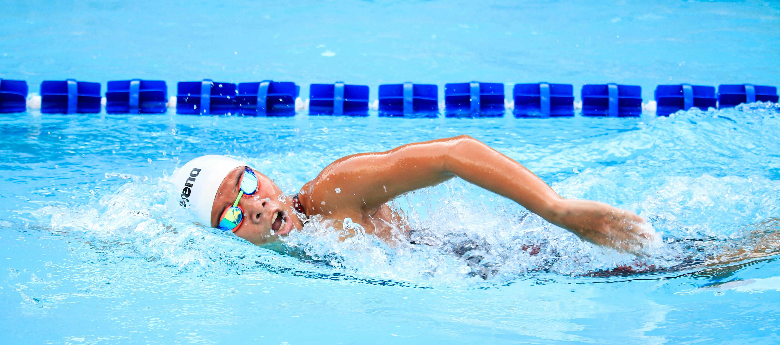
Resource Efficiency
Deep dive
#AQUAbossnX
June, 2025
Notes:
Imagine a swimmer in an Olympic pool — gliding through the water, every movement efficient, every breath timed.
Now imagine a dialysis center.
Different setting, same principle: performance depends on how well we manage our resources.” “And just like a swimmer needs water to compete, we need water — and energy — to care for our patients. Let’s talk about how we can do that with more precision, and less waste.”

Slide 2



Ressource Efficiency
For a swimmer, water is more than just an element - It's a partner and a sanctuary.
We all need water for different purposes
Notes:
Imagine a swimmer in an Olympic pool — gliding through the water, every movement efficient, every breath timed.
Now imagine a dialysis center.
Different setting, same principle: performance, and btw also the water bill of your center, depends on how well we manage our resources.
And just like a swimmer needs water to compete, we need water for the treatment of patients.

Slide 3
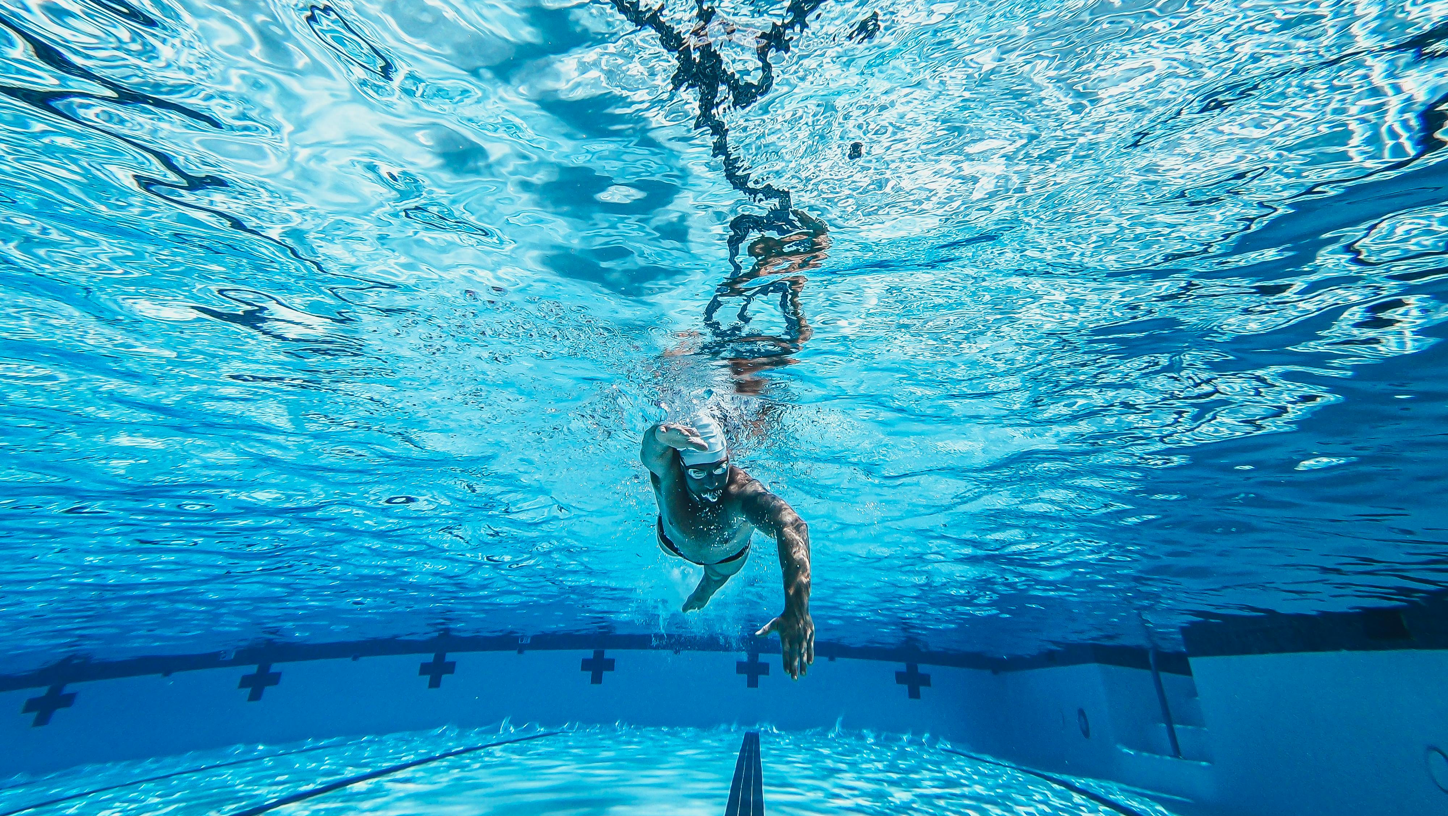
The swimmer needs water to compete, to train, to push limits.
Patients need it to survive.
Notes:
The difference is: The swimmer needs water to compete, to train, to push limits.
Patients need it to survive.
But water is not an infinite resource.
Only about 2.5% of all water on Earth is freshwater and only around 0.3% of the world’s freshwater is actually accessible to us.
We should therefore think together about how we can use water efficiently.

Slide 4
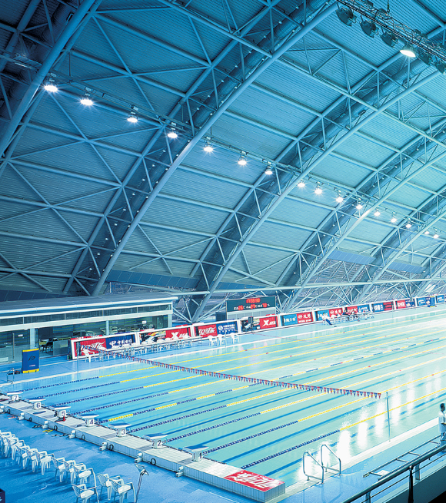

Ressource Efficiency
Average water consumption of a renal care center
. 7.140 Mio
Liter
For an average center with 100 patients
This is enough water to fill 2,5 Olympic pools a year!*
* Jiménez MDA, Audije-Gil J, Martínez R, et al. How to improve the environmental impact in haemodialysis: small actions, big changes. Clinical Kidney Journal. 2025 Feb;18(2):sfae407. DOI: 10.1093/ckj/sfae407. PMID: 39927256; PMCID: PMC11806634.
Notes:
Sounds like a lot? That’s because it is. But we can do better.

Slide 5
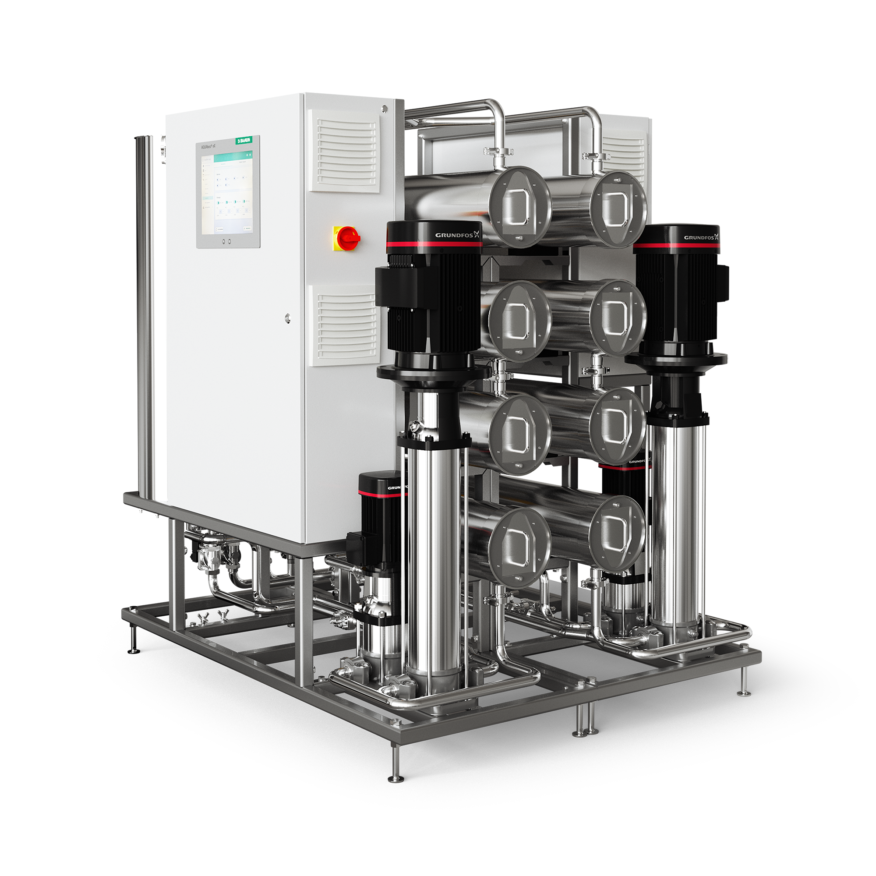

Ressource Efficiency
Water recovery rate
Up to 95%
of the input water is converted to permeate after removing impurities through a reverse osmosis system.
This means there is a potential of saving 10% more water in comparison to AQUAboss.
Notes:
With the new AQUAboss nX, up to 95% of input water is converted into permeate — thanks to advanced reverse osmosis.”
That’s up to 10% more water saved compared to the previous AQUAboss model.

Slide 6

Ressource Efficiency
The swimmer moves
because his heart pumps
Fueling effort, always in rhythm with the need
In every race, the heart delivers —
Circulating energy to drive performance

Slide 7

But not every moment demands full power
The heart responds to every demand with perfect precision — it listens & adapts

Slide 8

Ressource Efficiency
Whether in the pool or in treatment: Energy is a valuable resource. And especially in a resource-intensive therapy such as dialysis, a responsible approach is rewarding.
Reverse osmosis devices are considered as the “heart” of a dialysis unit.
So modern reverse osmosis devices should be just as efficiently, right?

Slide 9

Ressource Efficiency
Estimated European energy consumption for hemodialysis per year
Approx. 32,715
MWh
This amount of energy could power approximately a city of approximately 75,000 Dutch families.*
* ERA Congress 2025: Green Dialysis - Our shared responsibility - B. Braun

Slide 10
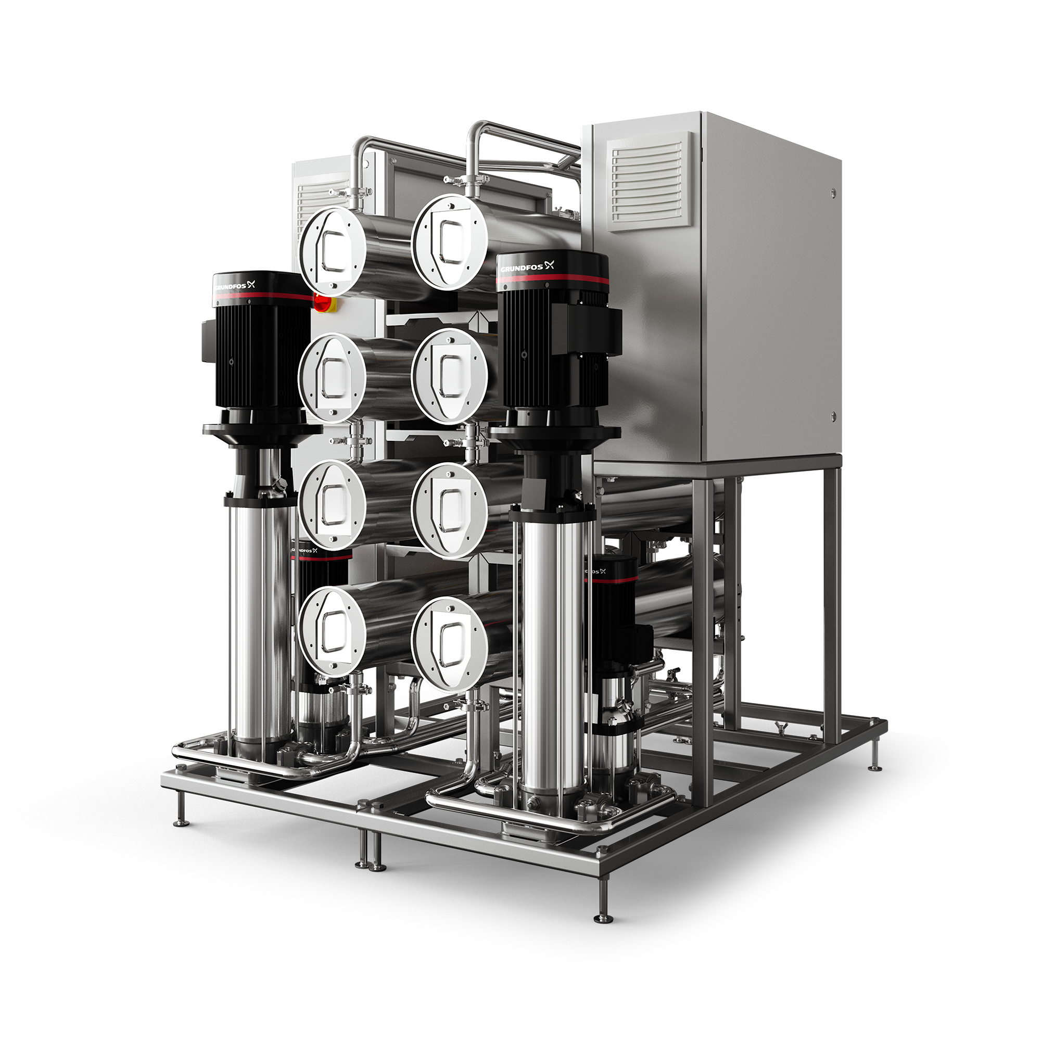
Ressource Efficiency
Lower consumption, more sustainability
AQUAboss nX is a demand driven reverse osmosis system featuring frequency-controlled pumps

Slide 11


Ressource Efficiency
Energy savings of
PATENTED TECHNOLOGY
Up to 65%
Thanks to multiple patents, AQUAboss® nX delivers a guaranteed minimum of 25% and up to 65% energy savings compared to AQUAboss®
For an average center with 100 patients this results in
This energy is enough to drive
an electric car around the world.*
7.650
Approx.
kW/h savings/year!
¹ Internal test report: Savings calculated according to performance KPI on 15000 treatments | *Electric car consumption: https://doi.org/10.1093/ndt/gfaa193

Slide 12
Thank you and stay healthy!
2025
Notes:
categoryEnd:slideEnd

