Slide 1

Reliable Operations with AQUAboss® nX
Deep dive
June, 2025
Notes:
CategoryTitle:SlideTitleBlockBottomRight

Slide 2

Airplanes - the safest means of transport in the world!
Why is that?

Slide 3

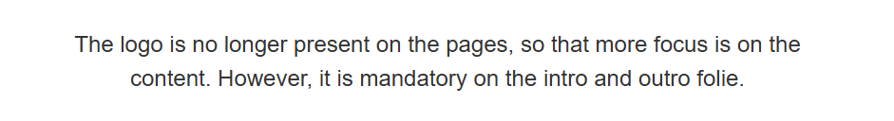
LOGO
PowerPoint guideline
Open the Powerpoint Guideline
Highly qualified staff!
During a flight, the pilot is responsible for passengers as well as for the flight crew!

Slide 4
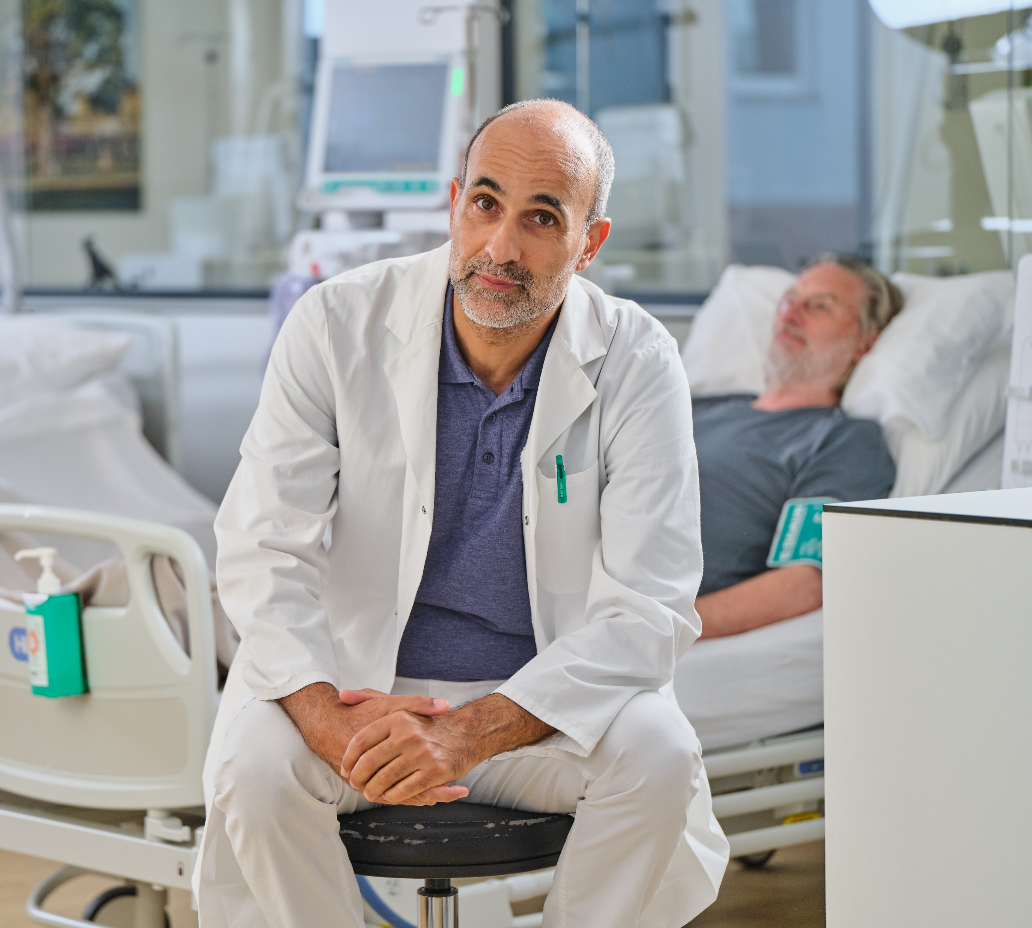

As a nephrologist, you are responsible for reliable patient treatments.

Slide 5

“Fail-Safe”-Principle – what´s that?
This means technical redundancy, automatic security systems, maintenance as well as emergency systems.

Slide 6
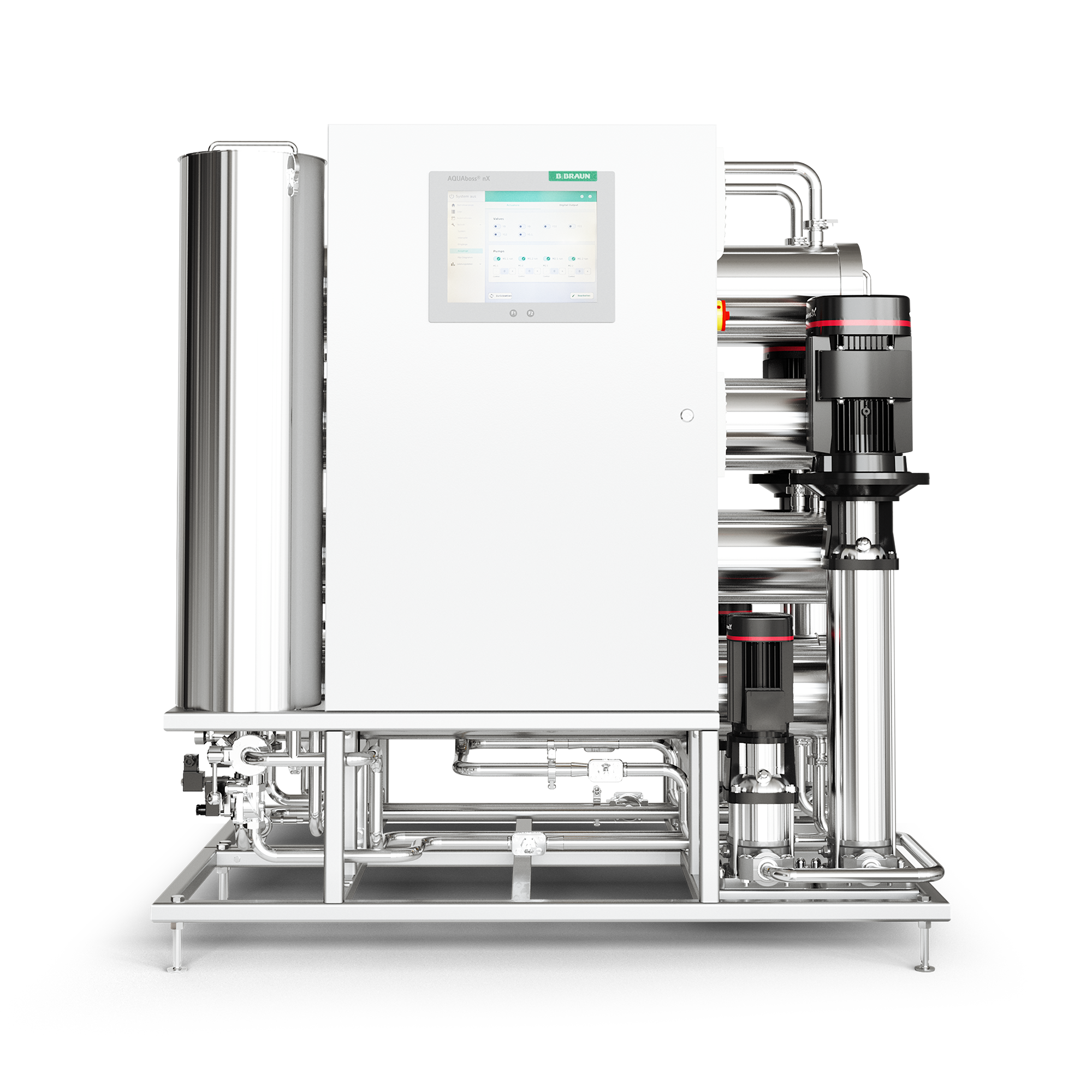

Reverse osmosis devices are considered as the “heart” of a dialysis unit.
There is no WTS backup, thus product availability is key!
AQUAboss nX

Slide 7

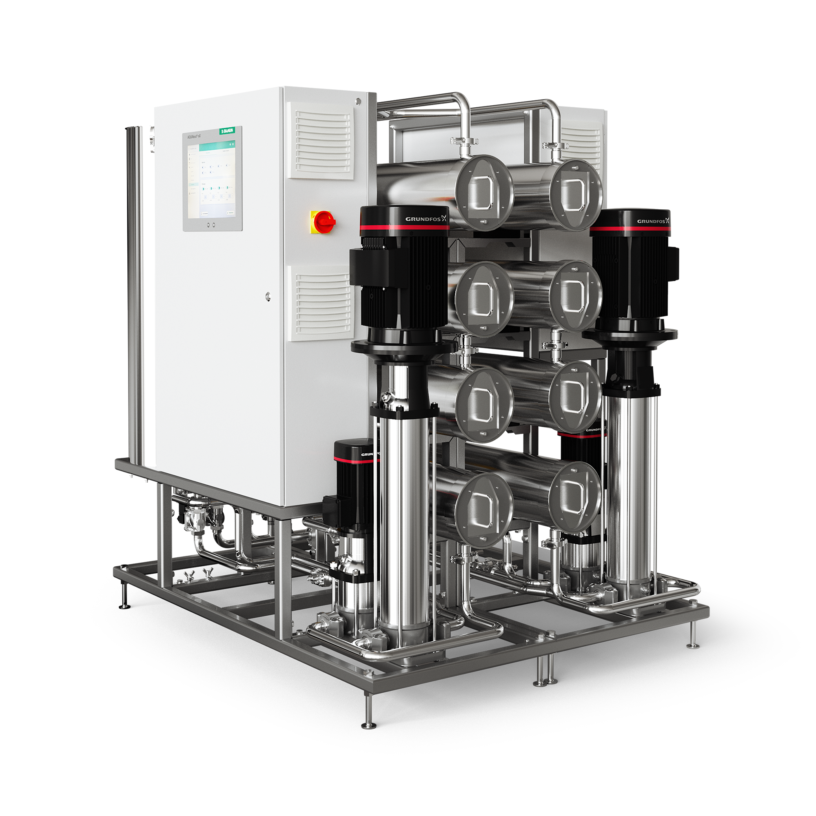



Component test
Automatic emergency mode
Display emergency mode
What is the AQUAboss nX „fail-safe“ principle?
The “fail-safe” principle of AQUAboss nX
ensures continuous and secure operation

Slide 8
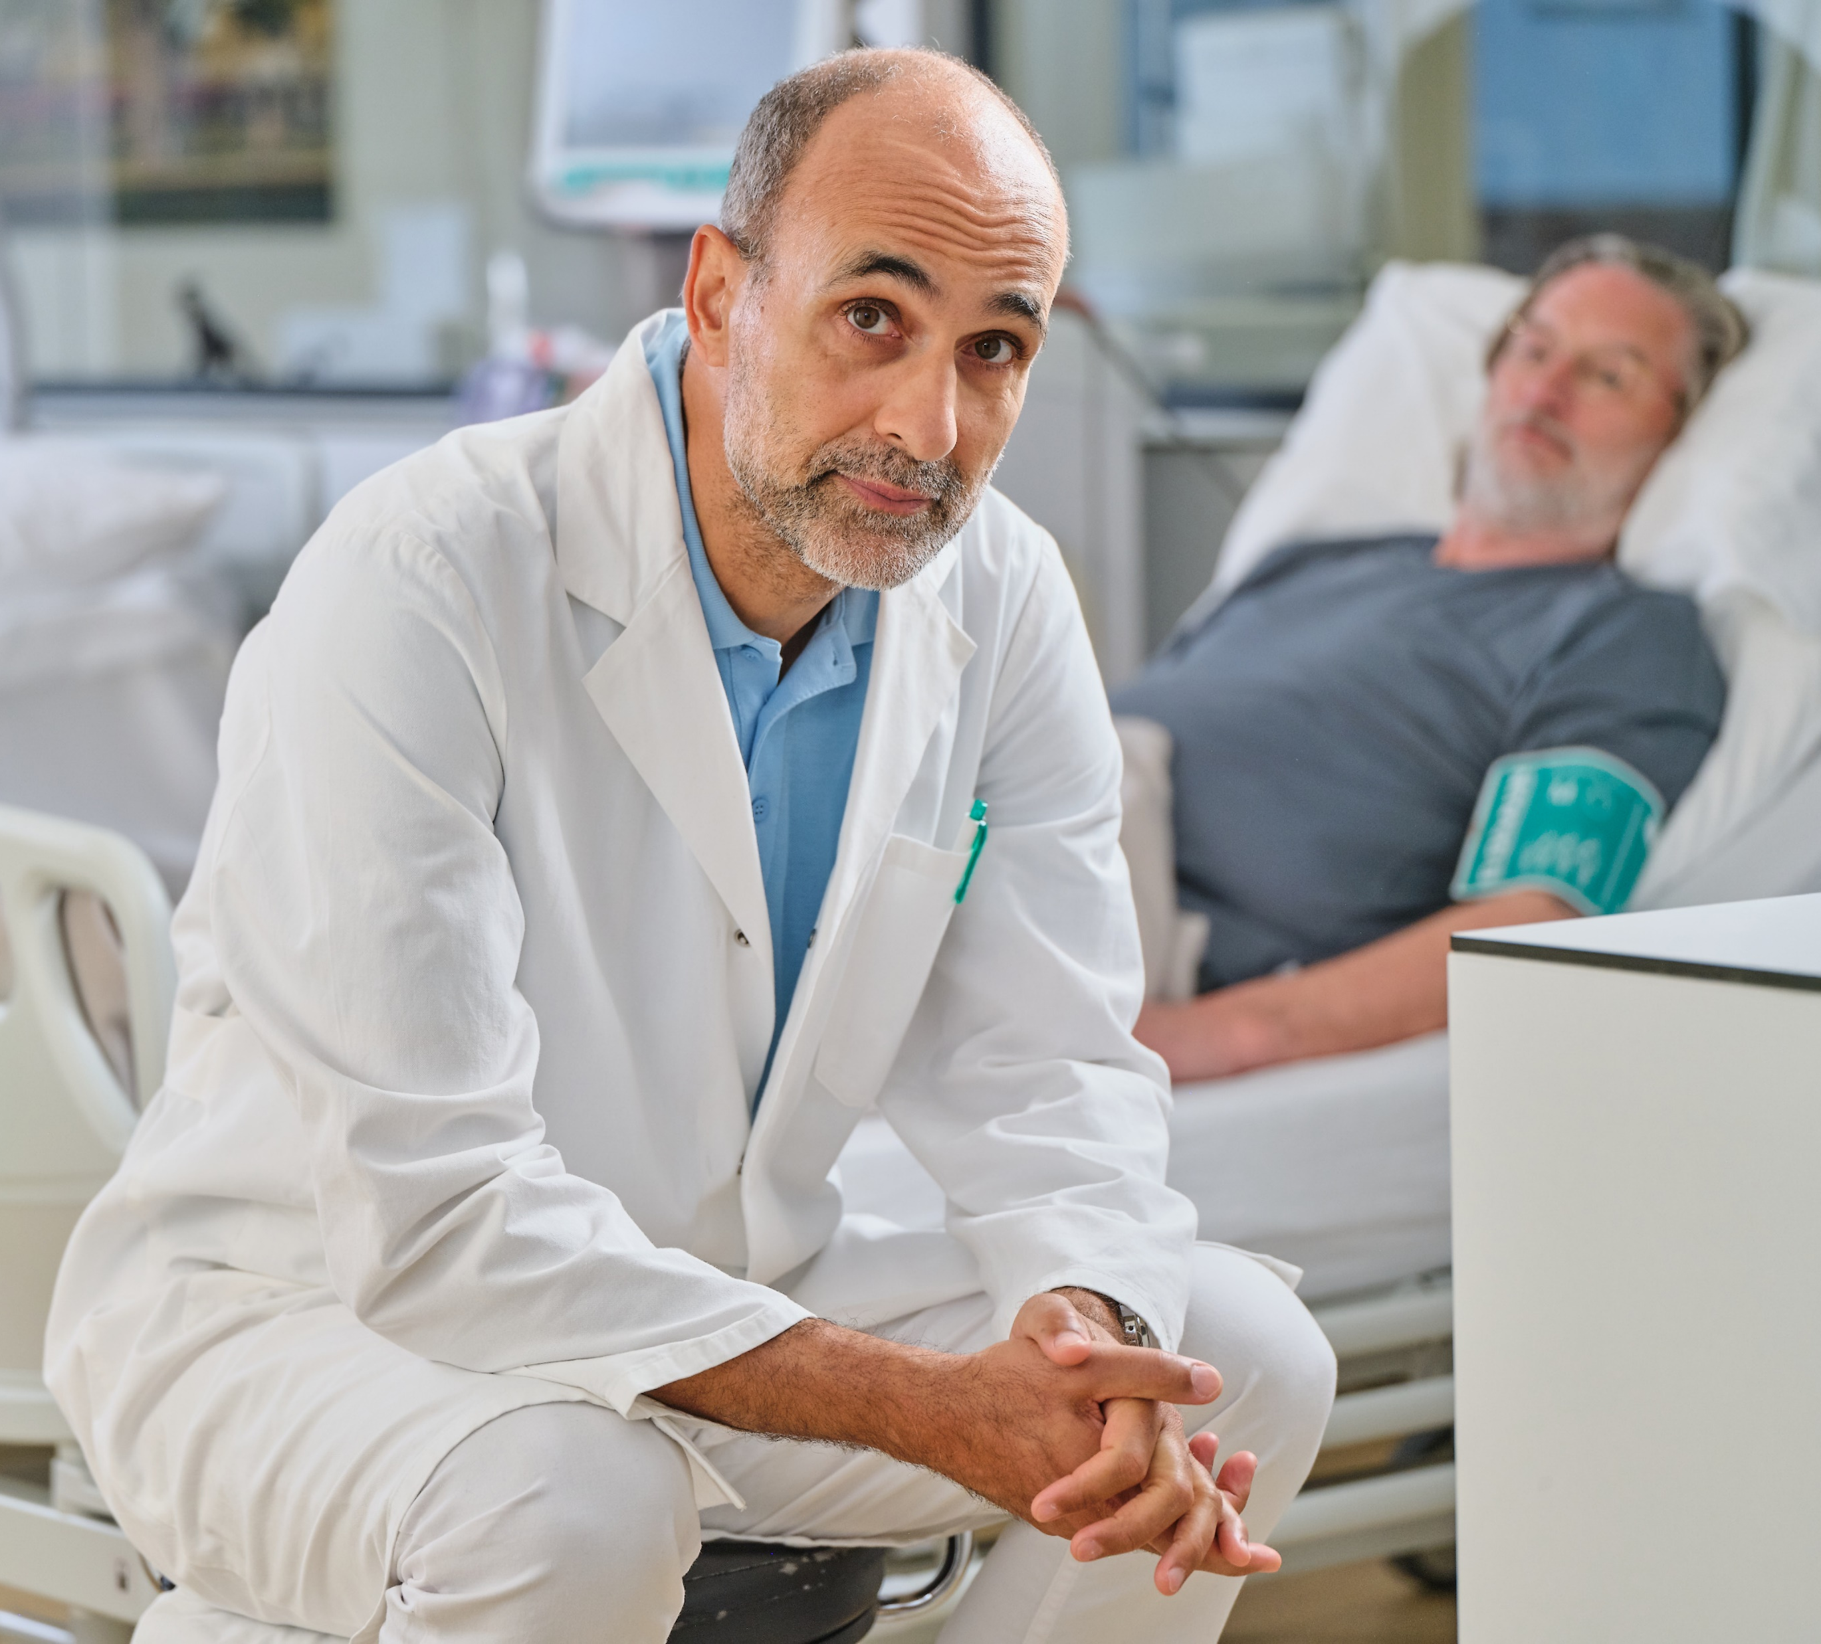
WE
feel responsible!
It is not only the nephrologist´s responsibility to ensure patient treatments.
With AQUAboss nX it becomes a shared responsibility, because we as B. Braun feel responsible for enabling reliable and high quality patient treatments.

Slide 9
Thank you and stay healthy!
2025
Notes:
categoryEnd:slideEnd

