Slide 1
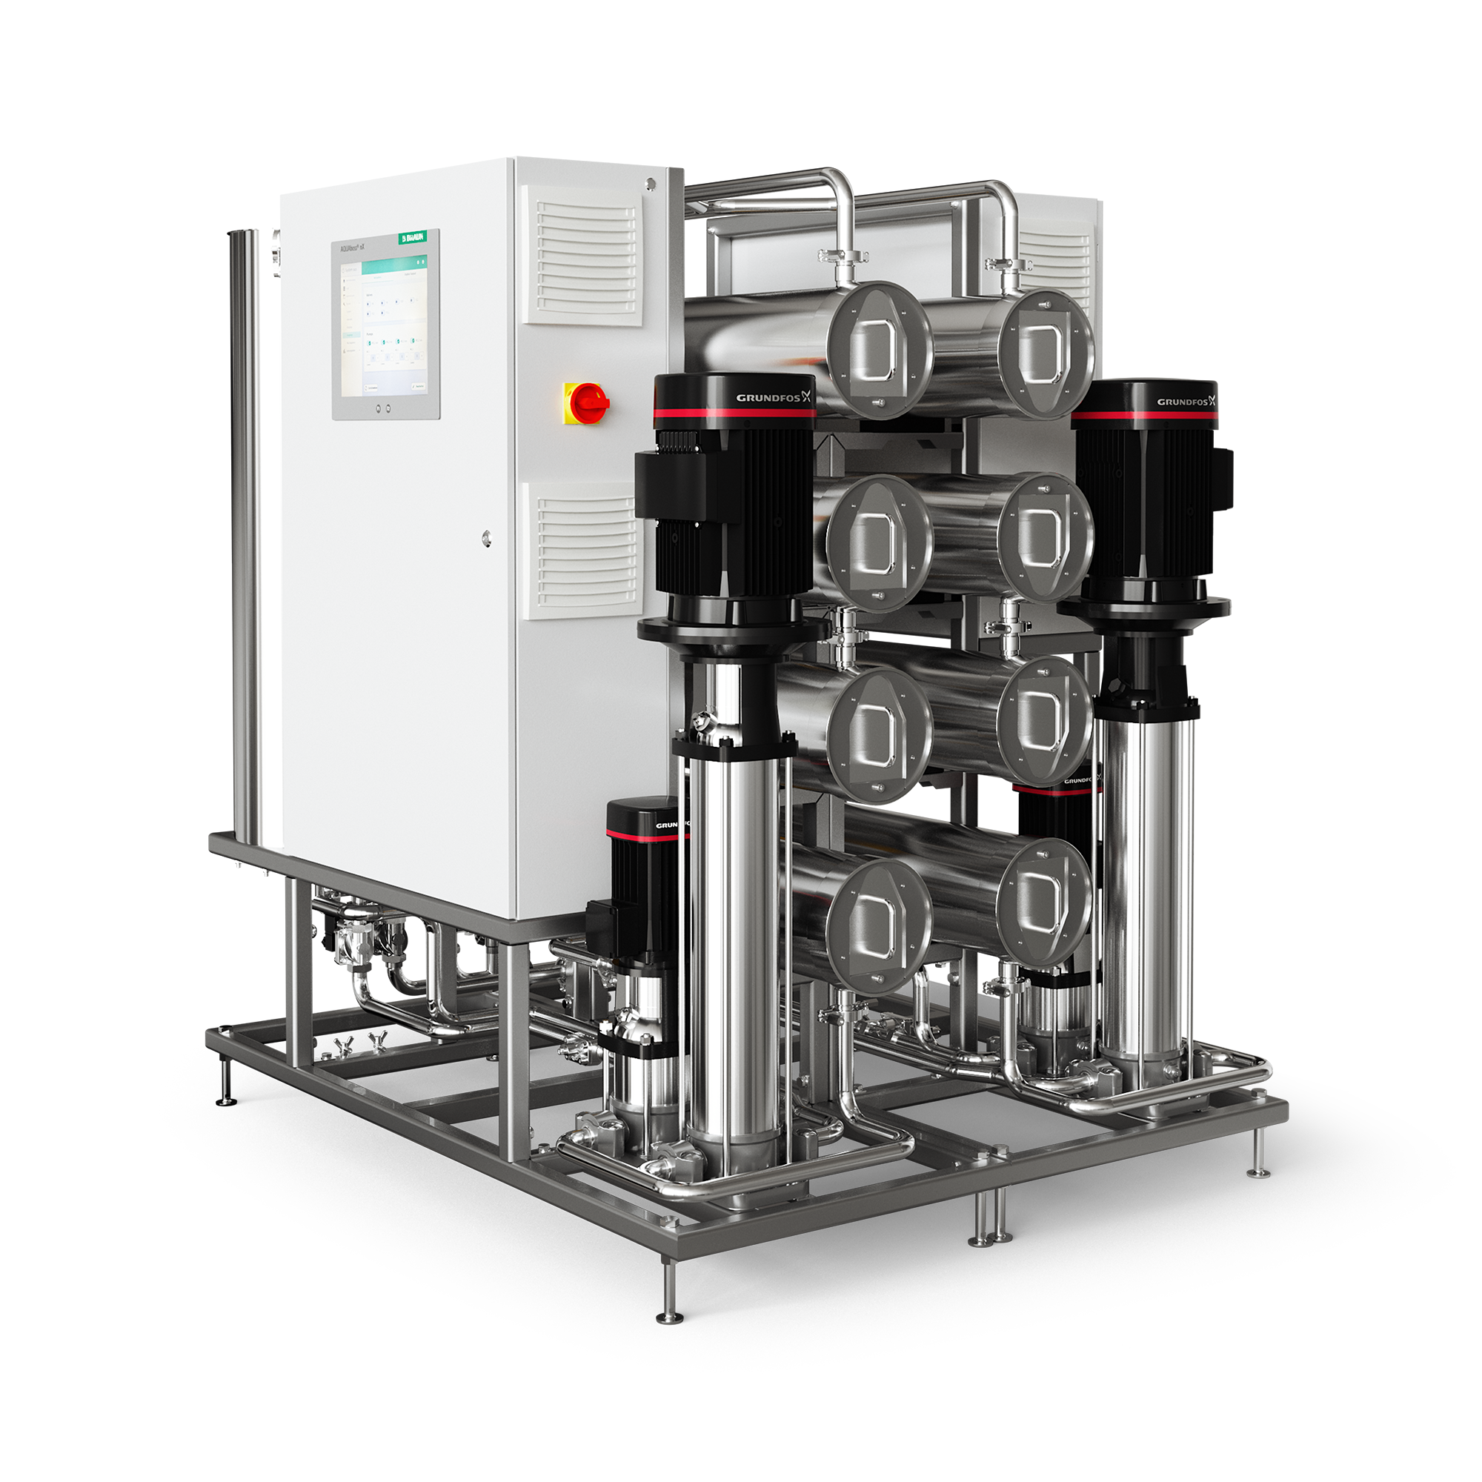
AQUAboss® nX
Reverse osmosis device
Disinfection frequency
Resource efficiency
more
Reliable operations
more
Leveled-up usability concept
more

Slide 2
Resource efficiency
1
5
Power consumption reduction
Longevity
2
Water recovery rate
4
Standby mode
3
Heat disinfection

Slide 3

Power consumption reduction
Energy savings of
PATENTED TECHNOLOGY³
up to 65%
Thanks to multiple patents, AQUAboss nX delivers a guaranteed minimum of 25% and up to 65% energy savings compared to AQUAboss.
For an average center with 100 patients, this results in approx.
7,650 kW/h savings per year!¹
This energy is enough to drive
an electric car around the world.²
¹ Internal test report: Savings calculated according to performance KPI on 15,000 treatments
² Blankestijn PJ, Bruchfeld A, Cozzolino M, Fliser D, Fouque D, Gansevoort R, Goumenos D, Massy ZA, Rychlık I, Soler MJ, Stevens K, Zoccali C. Nephrology: achieving sustainability. Nephrol Dial Transplant. 2020 Dec 4;35(12):2030-2033. doi: 10.1093/ndt/gfaa193. PMID: 32901289.
³ Patent application pending at least in Germany

Slide 4


Water recovery rate
Water recovery rate
up to 95%
of the input water is converted to permeate after
removing impurities through the AQUAboss nX reverse osmosis system.¹
This means that with AQUAboss nX, it is possible to discard only 5% of the raw water during the process.¹
¹ According to internal test reports
² At a water recovery rate of 95%

Slide 5
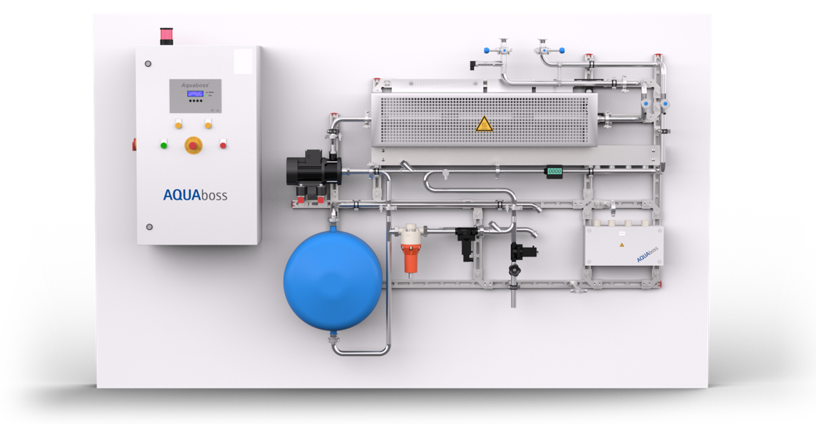
Hot Rinse Smart
Heat disinfection
The Hot Rinse Smart heat-on-demand disinfection method only consumes energy during the disinfection cycle.
Hot Rinse Smart can be a chemical-free disinfection solution.

Slide 6

Heat disinfection
ECO heat-on-demand disinfection
PATENTED TECHNOLOGY³
Offers fully automated heat disinfection (HRS)¹
Uses the A0 value as a measure of disinfection efficiency²
Reduces hot water consumption for reaching target A0²
AQUAboss nX automatically calculates
an efficient combination of temperature and time to reach your desired target A0 value!²
You set the target, AQUAboss nX
reaches it the efficient way.
¹ According to internal test reports and thermal disinfection test
² According to internal test report
³ Patent application pending at least in Germany

Slide 7
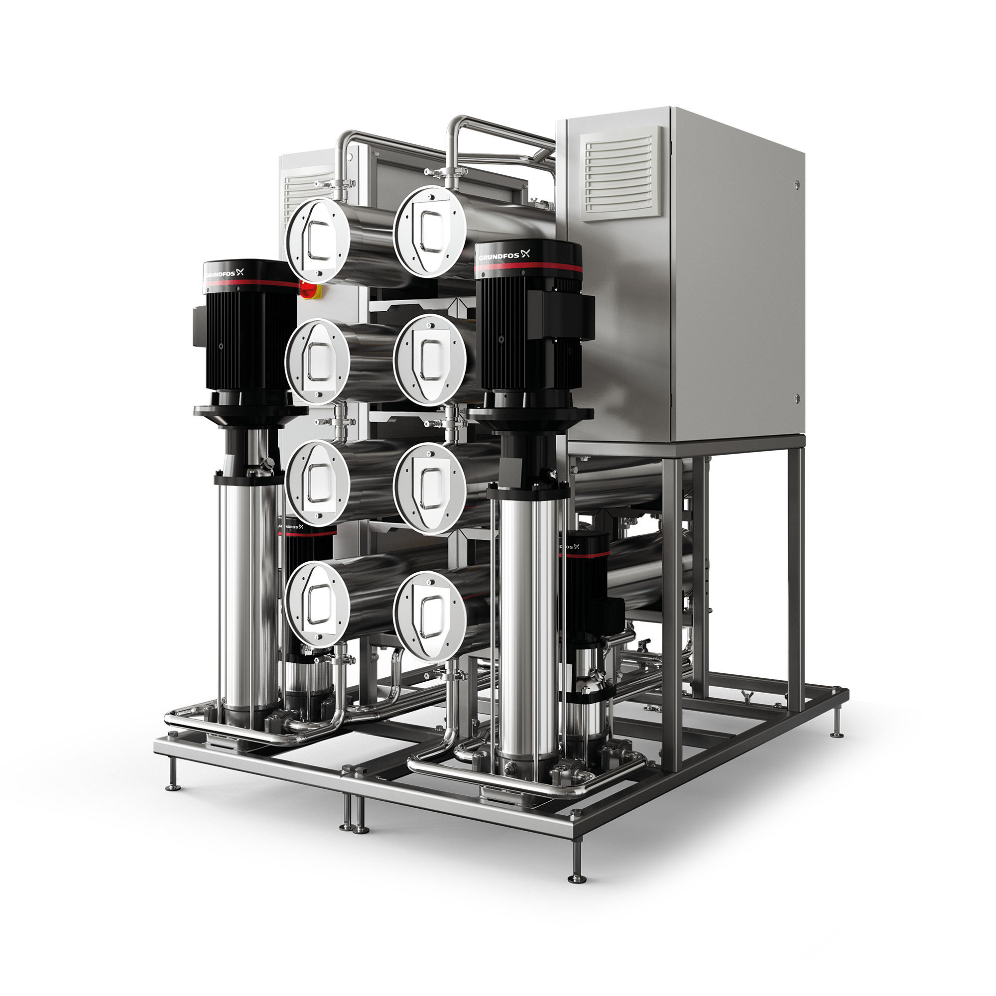
Standby mode
Resource efficiency
No water consumption during regular standby mode.¹
¹ No water consumption as long as permeate conductivity and temperature limits are not exceeded.

Slide 9
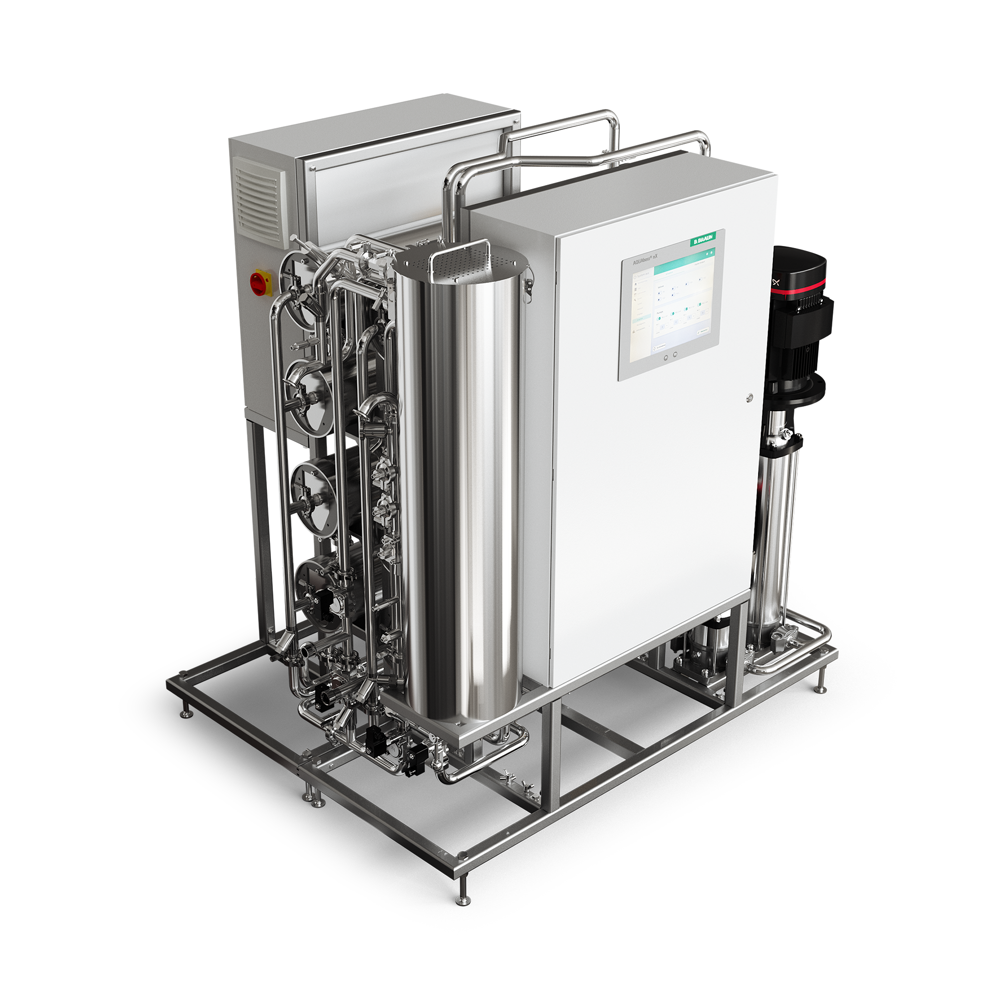
Reliable operations
4
1
Emergency mode
Component test
3
Multiple design setups
2
Maintenance interval

Slide 10

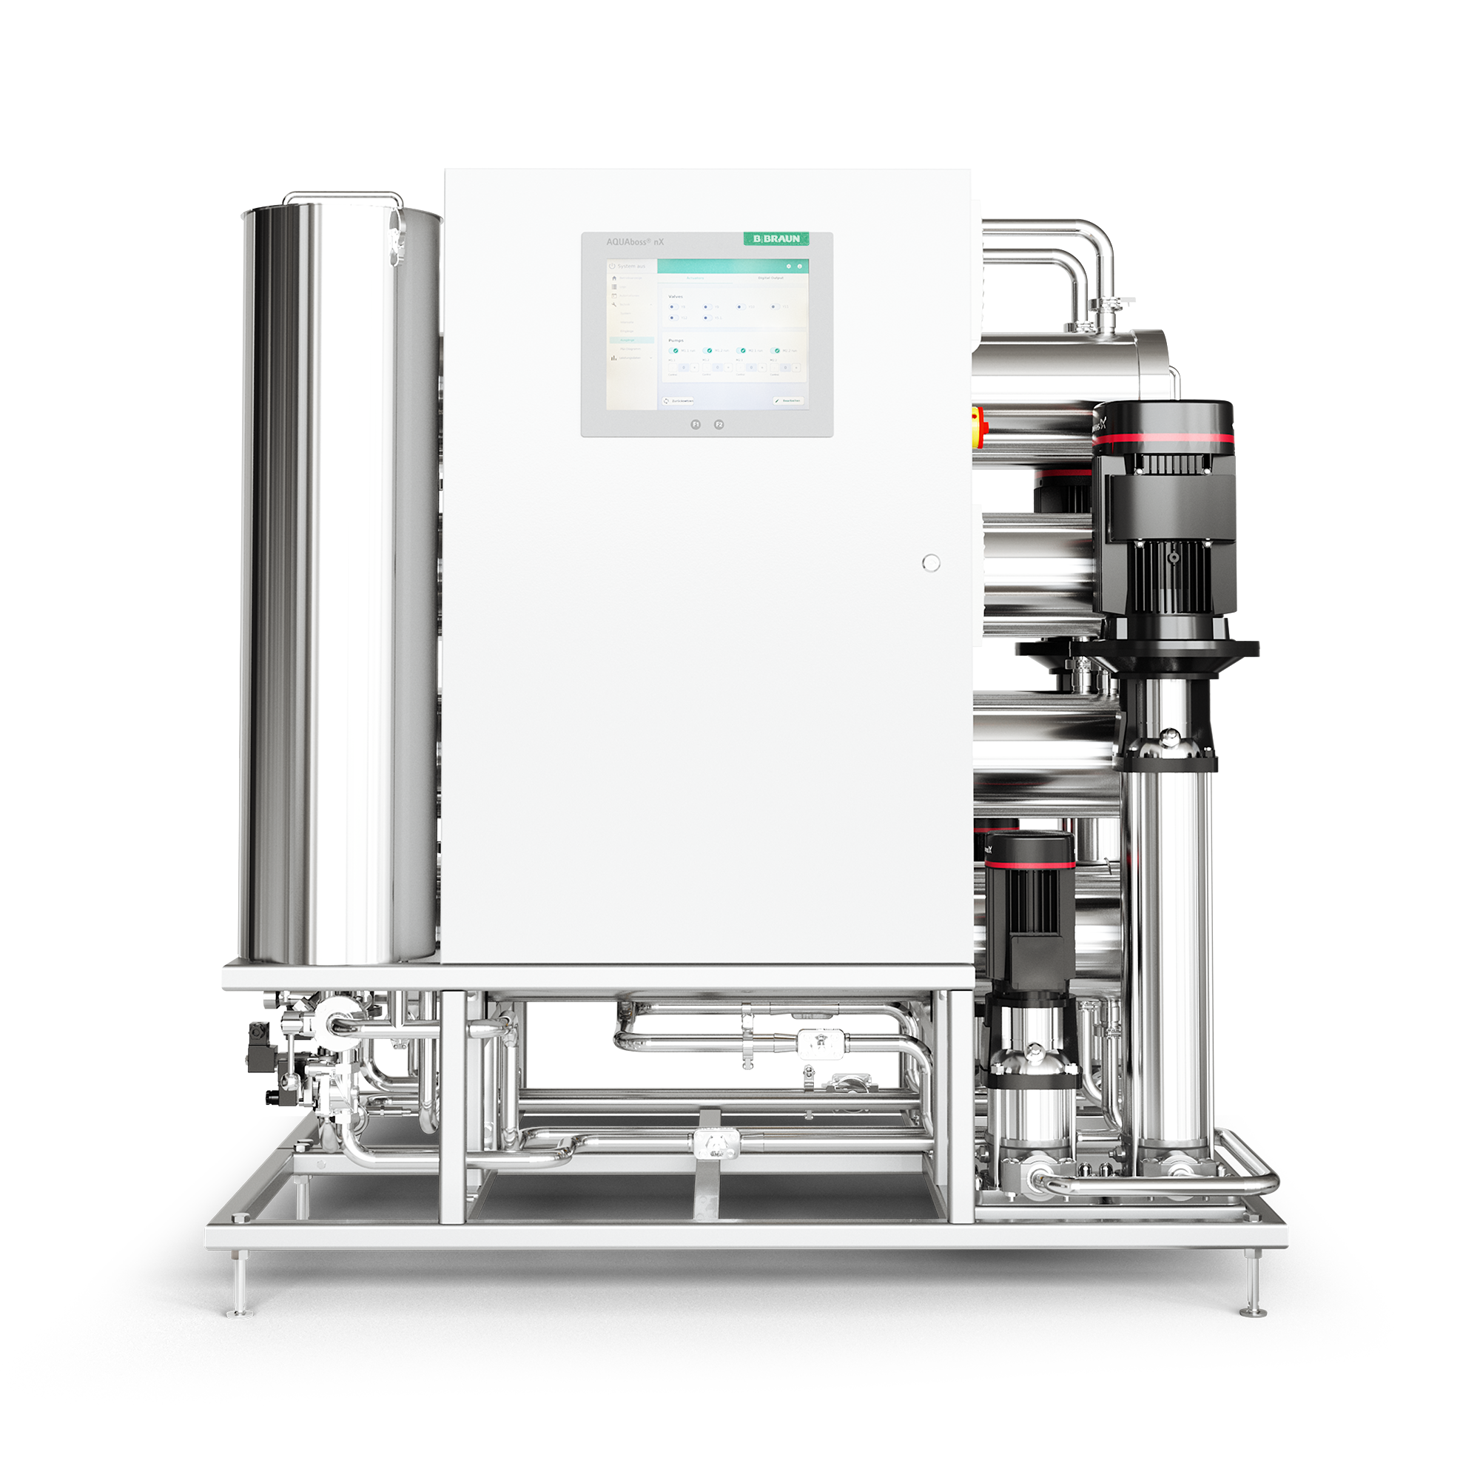
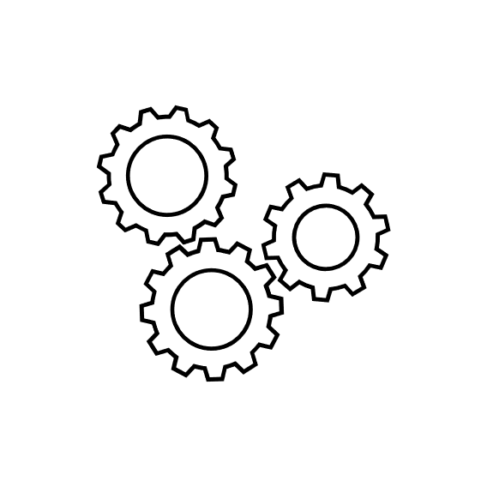
Reliability
Component test
PATENTED TECHNOLOGY³
Thoroughly checks each solenoid valve automatically after every restart or on demand
Benefits:
Helps to ensure smooth and safe system operation autonomously
Helps to prevent technical misdiagnosis¹
Efficient maintenance: No more manual control of actuators and sensors
¹ According to internal test report
² Patent application pending at least in Germany

Slide 11
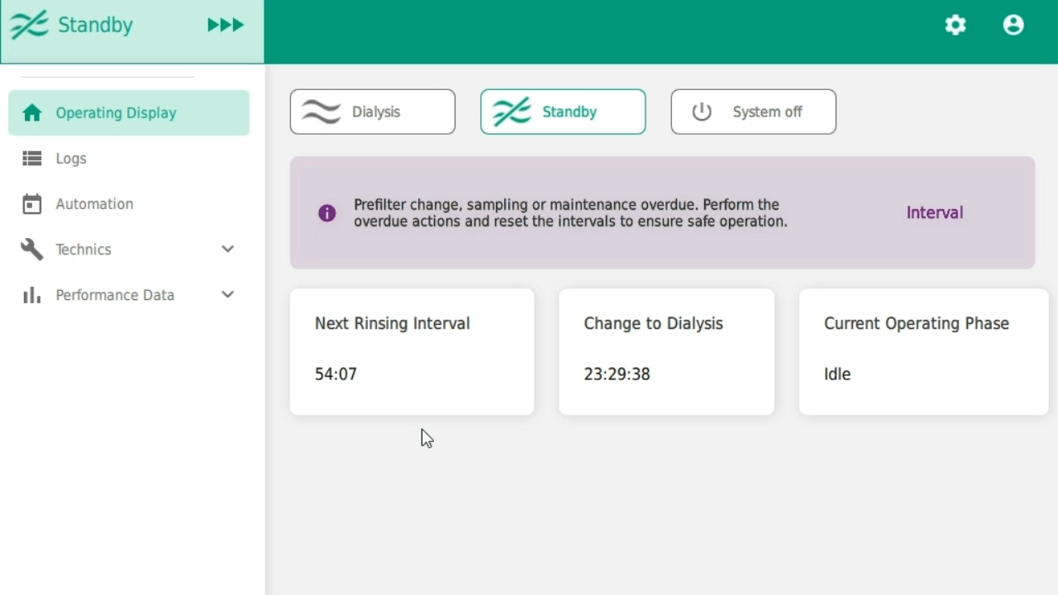
Reliability
A quick look at the component test …

Slide 12
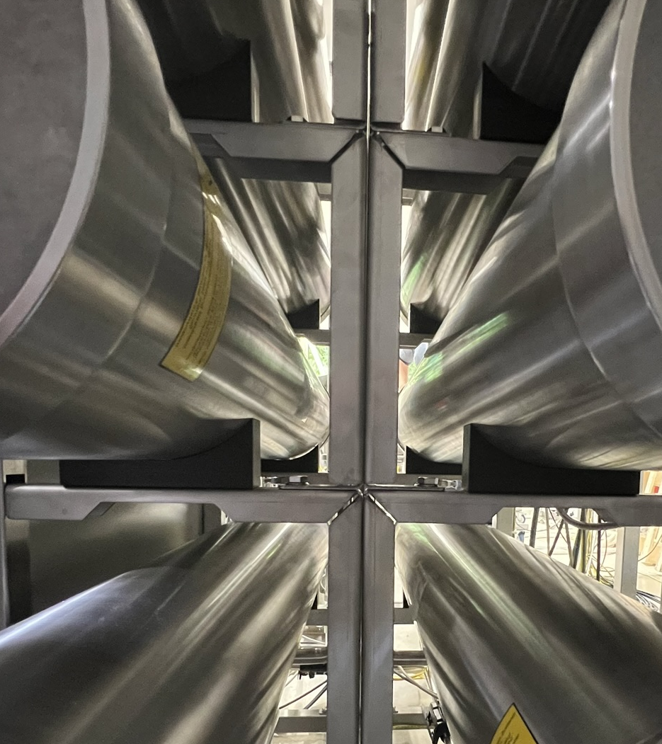
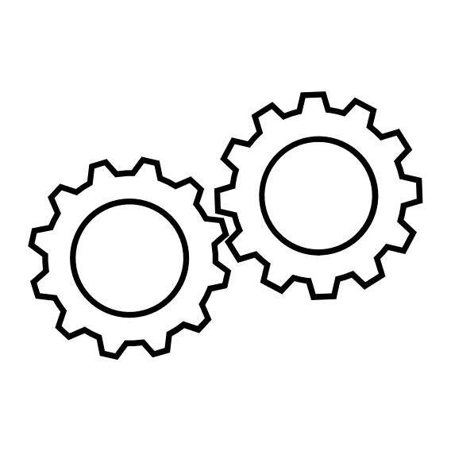
Reliability
Maintenance interval: 24 months!
Horizontally placed membranes
Fewer screws for opening membrane housing¹
Extended maintenance interval of 24 months¹
Save time!
Membranes can be replaced
without the need to dismantle the membrane housing.
With AQUAboss nX, maintenance runs efficiently, is completed more quickly and needs to be carried out less frequently!¹
¹ Compared to AQUAboss, with 12-month maintenance interval.

Slide 13
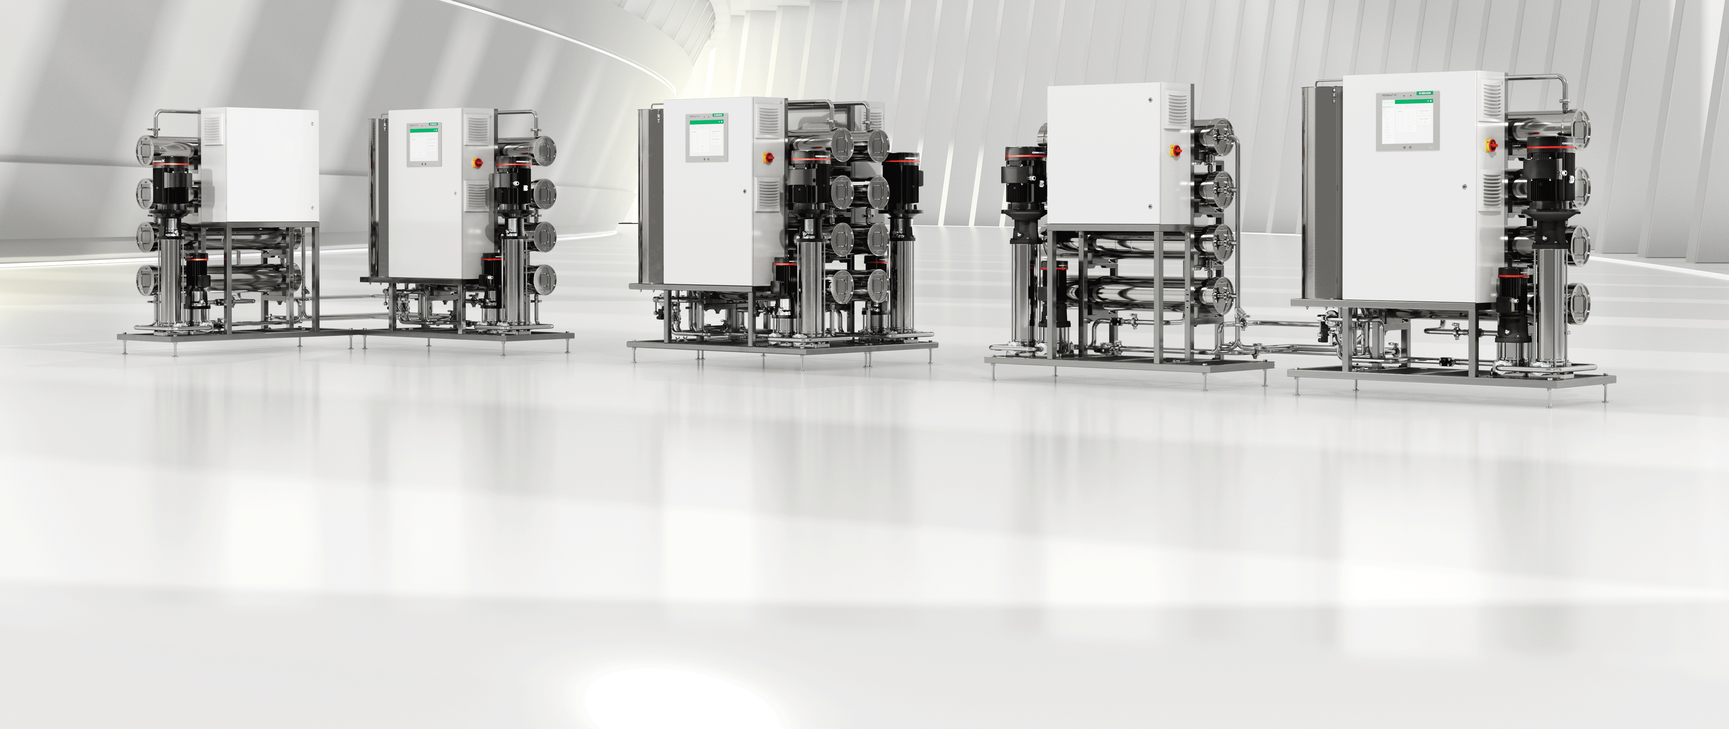

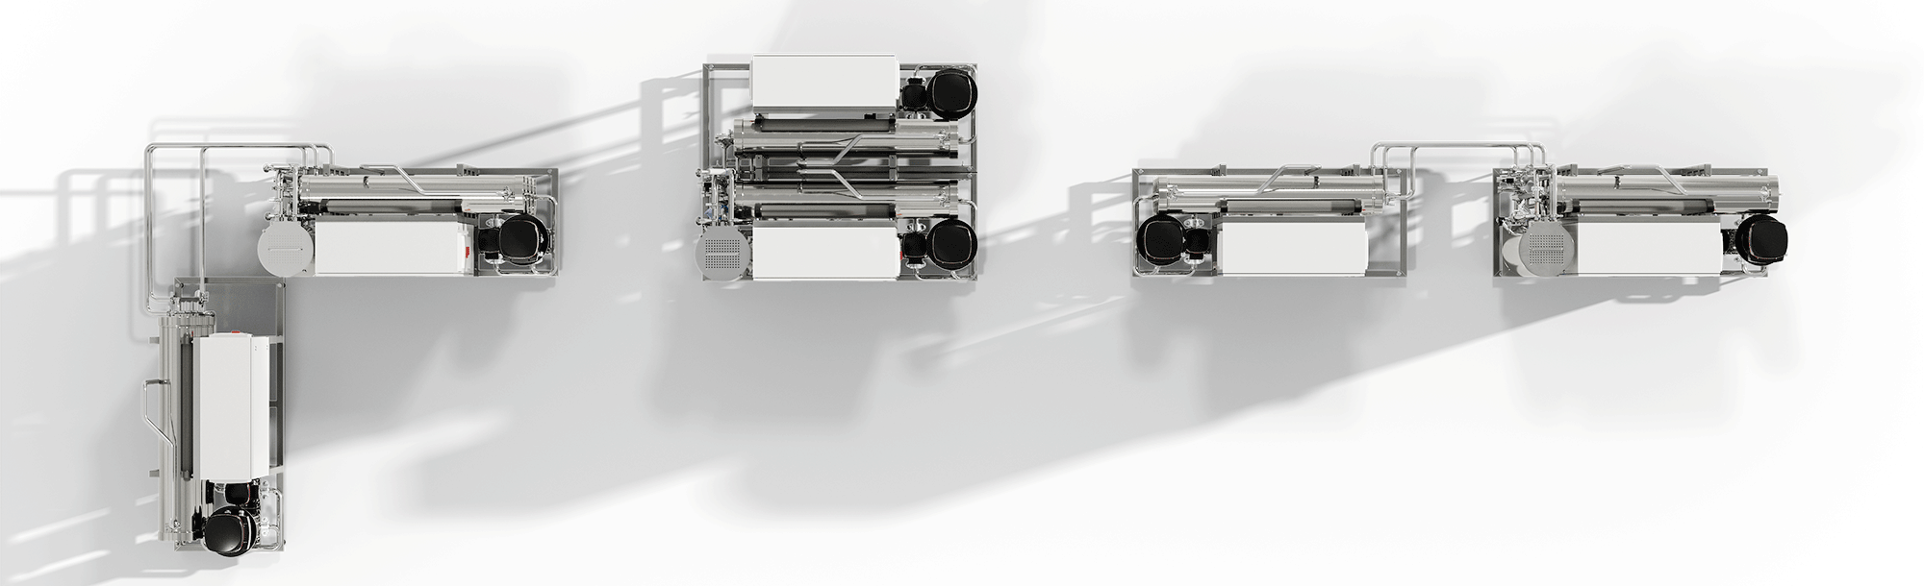
Reliability
AQUAboss nX is tailored to your needs!
Our double-stage device can be set up in a linear arrangement, as a cube, or as an L shape.

Slide 14

Reliability
Automatic emergency mode
PATENTED TECHNOLOGY¹
Fully automated bypass of a stage in the event of a failure
Full system monitoring
Redundant conductivity monitoring
No manual valve positions or manual opening of valves
AQUAboss nX automatically switches to emergency mode and helps to ensure a fully automated permeate supply for your patients.
AQUAboss nX takes care of the continuous permeate supply in the event of an alarm –
no immediate action necessary from nurses or technicians.
¹ Patent application pending at least in Germany

Slide 15
Leveled-up usability concept
1
Remote monitoring
3
Quiet operation
2
Display emergency mode

Slide 16
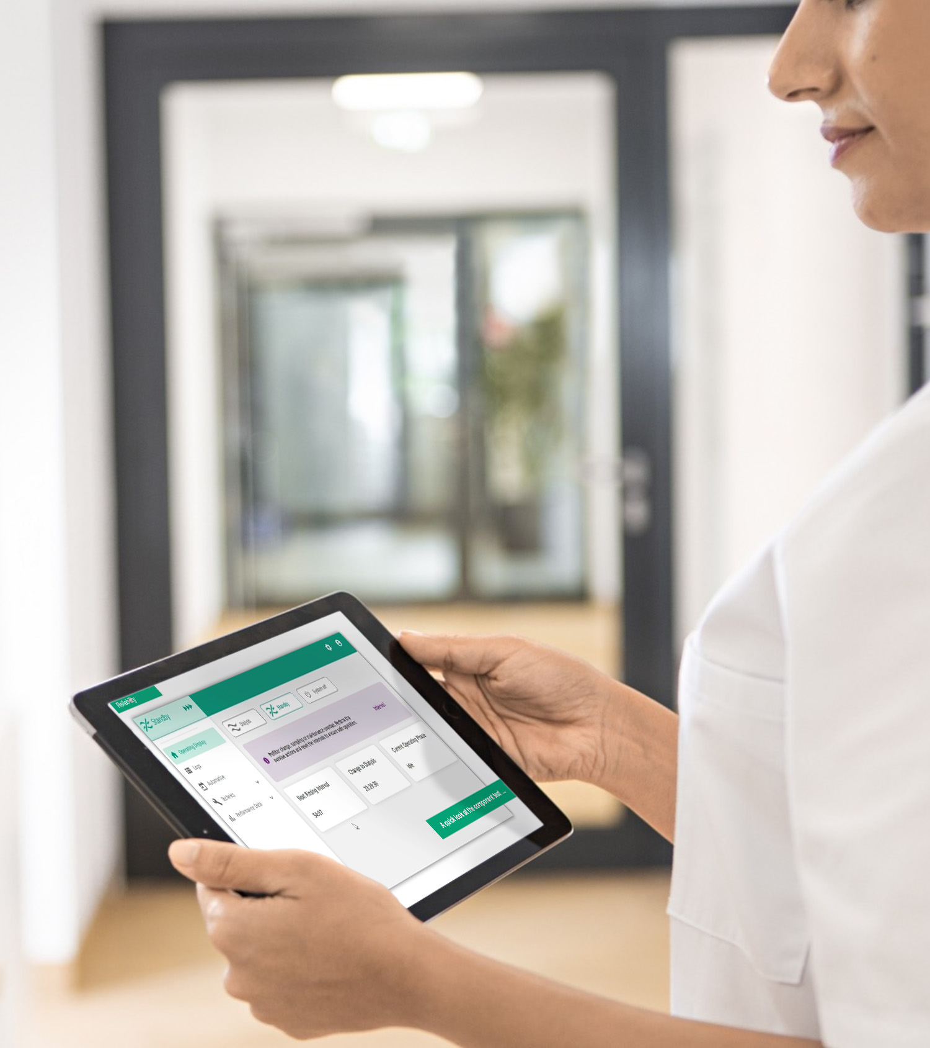

Leveled-up usability
Stay connected!
Remote and on-device monitoring
15” touchscreen
Monitoring software as standard
Dual-conductivity monitoring
Important parameters can be
monitored, whether on the display or remotely, wherever you are!
AQUAboss nX monitors and visualizes permeate temperature, conductivity, and flow, displaying this data remotely and on the screen as a graph.

Slide 17
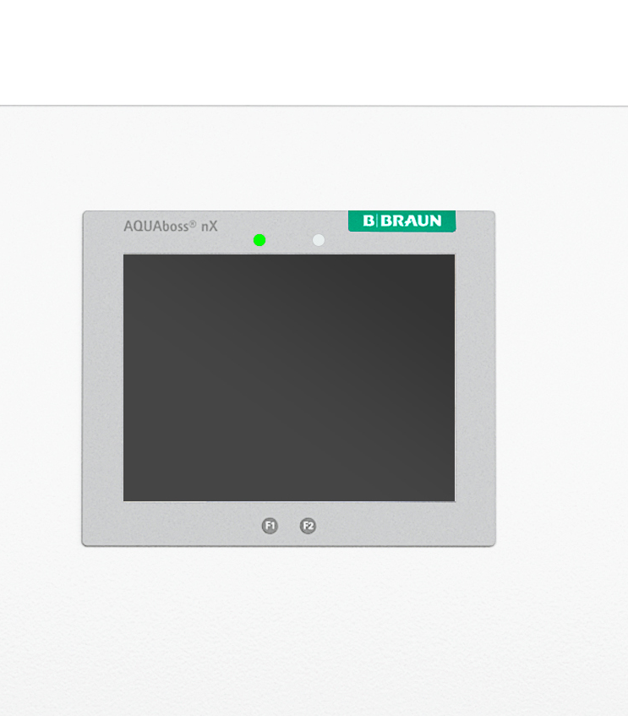

Leveled-up usability
Display emergency mode
Permeate supply is ensured, even in the event of
display failure
System can be operated at the touch of a button; status display via light signal
AQUAboss nX has a multifaceted safety concept that also takes display failure into account.
In the event of a display failure, AQUAboss nX continues to work with all other functions.

Slide 18
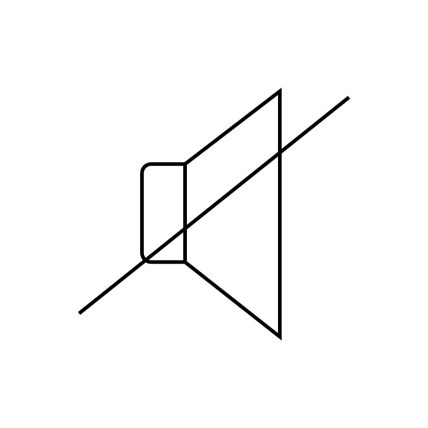
Leveled-up usability
Quiet operation
<80 dB
Thanks to the improved operating mode of AQUAboss nX, no hearing protection is required when working in the vicinity of the system, as the upper limit of 80 dB is not exceeded.¹
¹ AQUAboss nX – IFU, page 29

