Slide 1

There is a new boss in town…

Slide 2
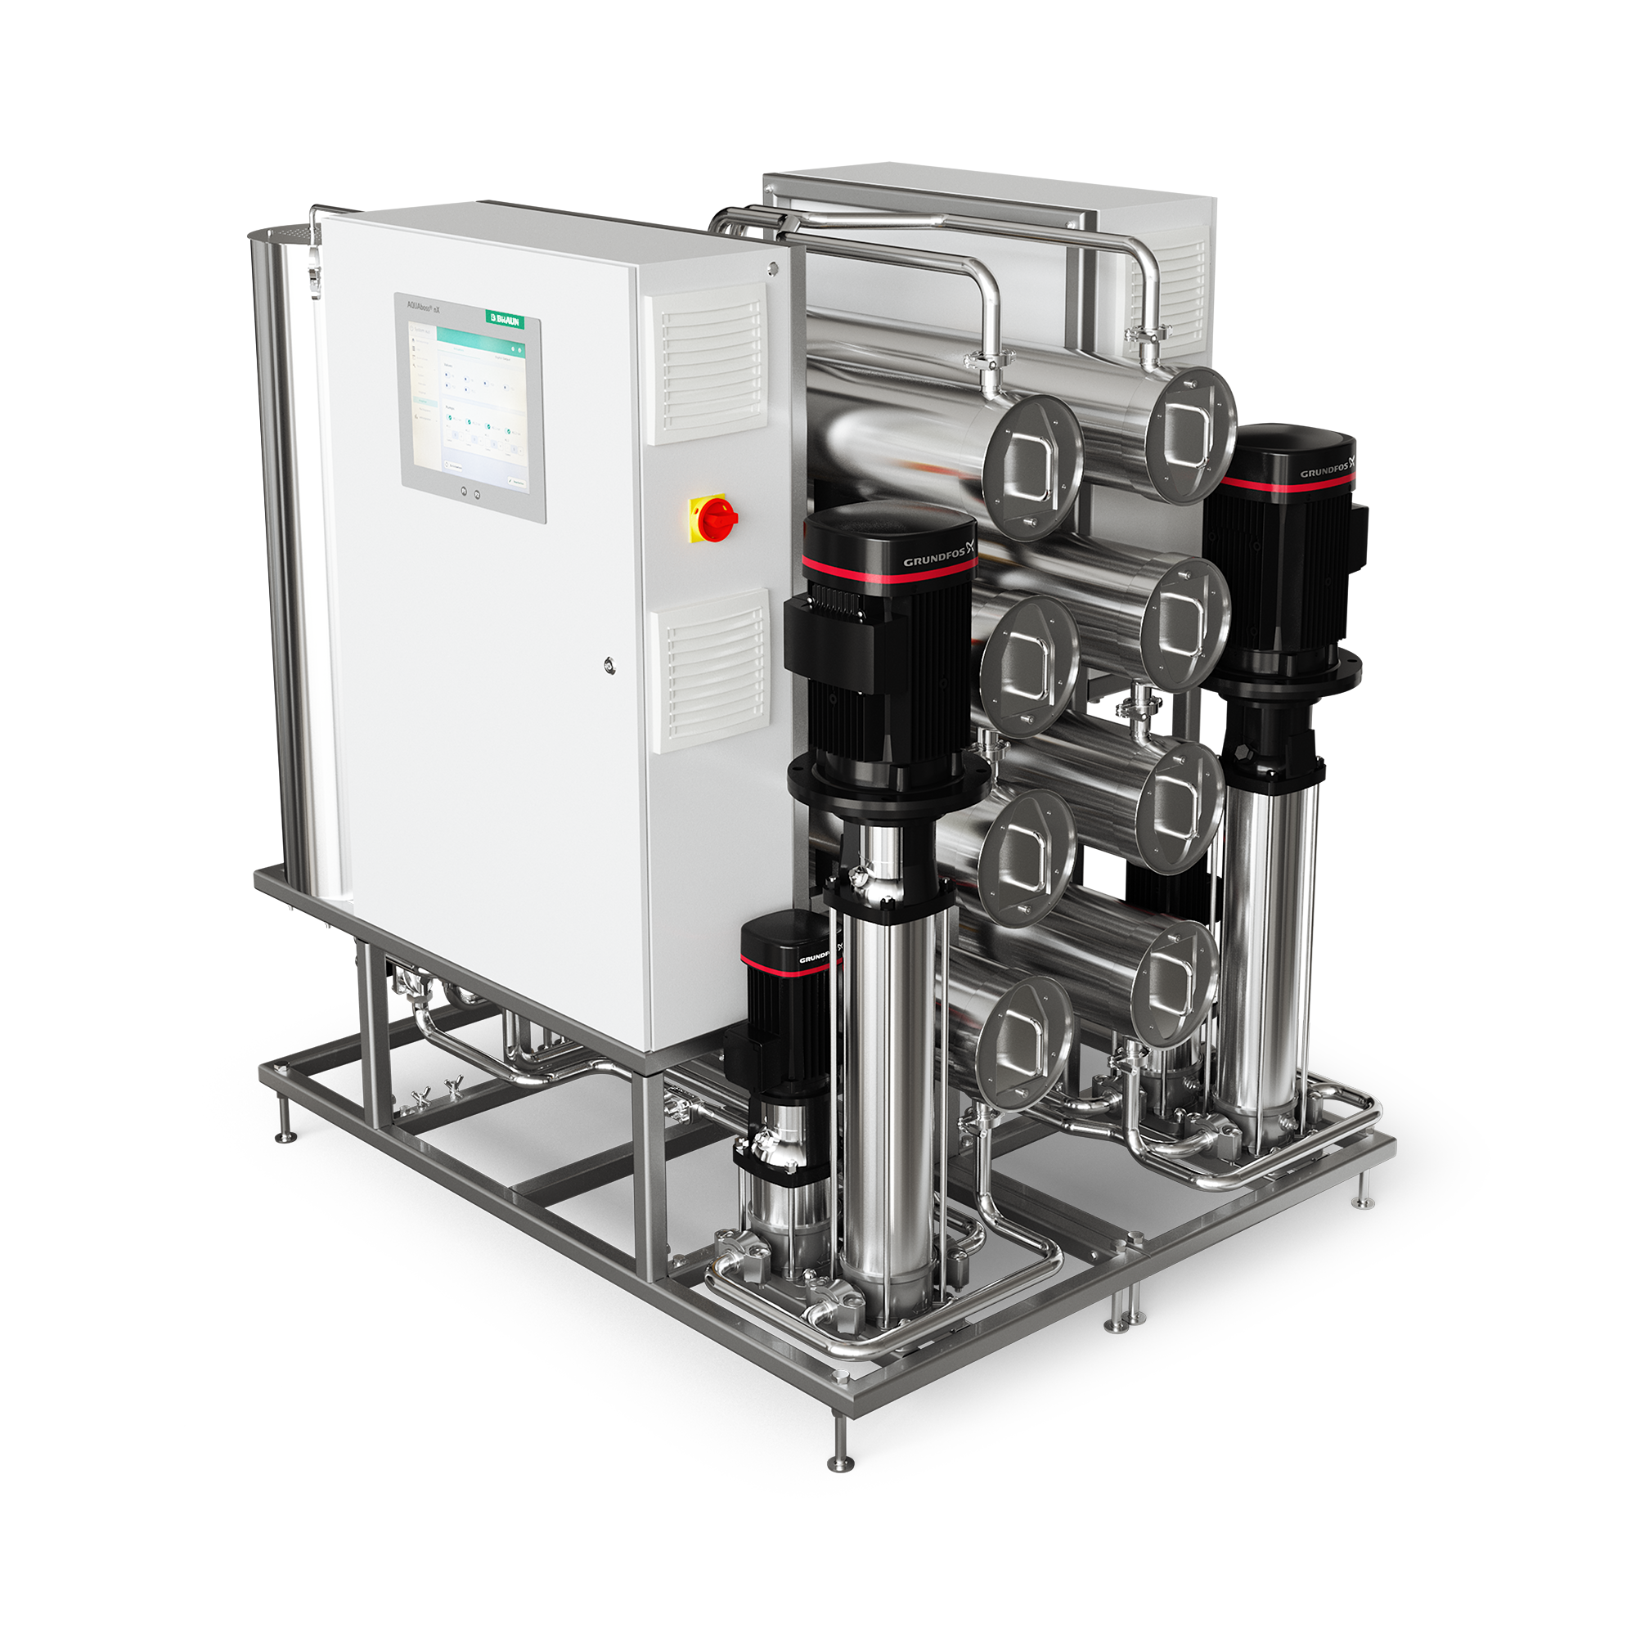

Named:
AQUAboss® nX
2
B. Braun Group
Notes:
categoryimage:slideImageTextHalf

Slide 3
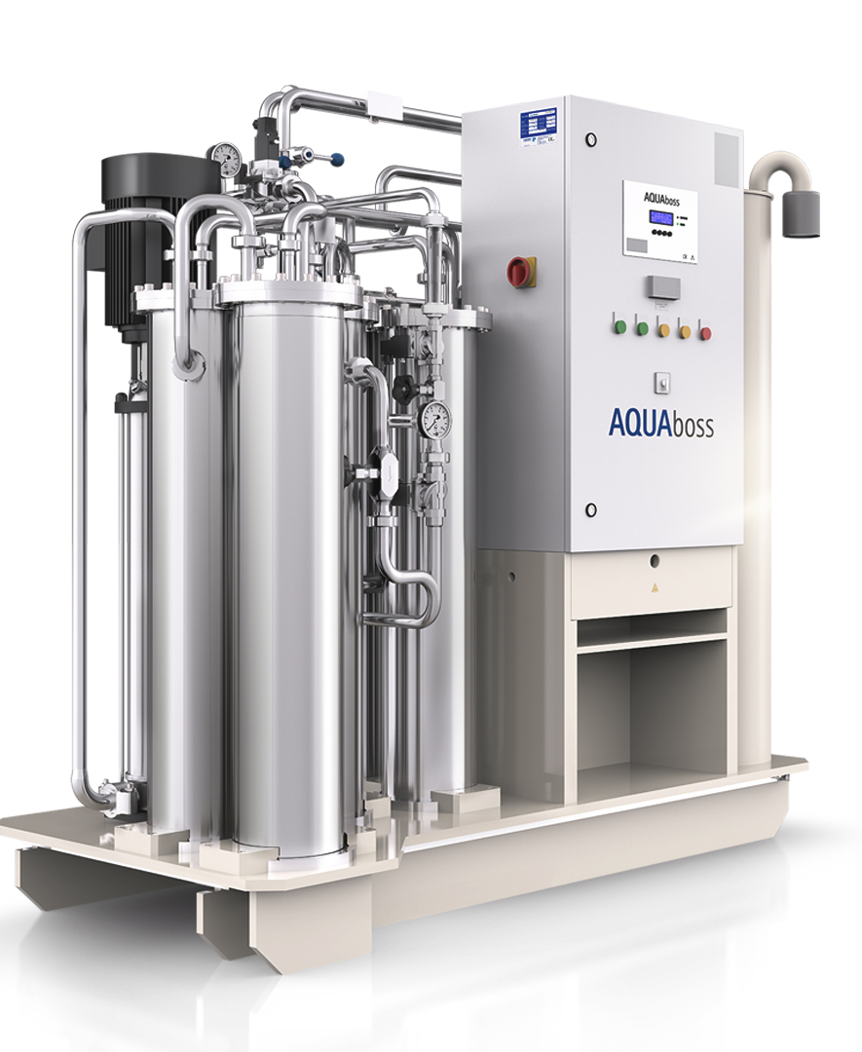

Today´s AQUAboss series
Innovation leader since the 1990´s! More than 2.000 installations worldwide.
Hey AQUAboss, you´re (way) too loud!
AQUAboss, your monitoring software is outdated!
Your energy consumption is „only“ average!

Slide 4
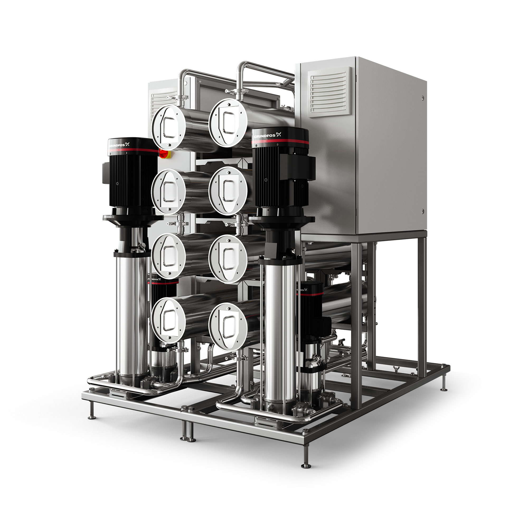
AQUAboss nX is a multitalent!
Small, medium or big?
| Capacities from 500 – 4.000 l/h
Single or double?
| Single or double stage devices
Hot or cold? Or both?
| Available with chemical, heat or total heat disinfection
Not sure? No worries!
| Upgrade capacities, disinfection or redundancy any time!

Slide 5
Multitalent
[Mul|ti|ta|lent], noun
Versatile technical device equipped with a wide range of functions that meets many user requirements

Slide 6


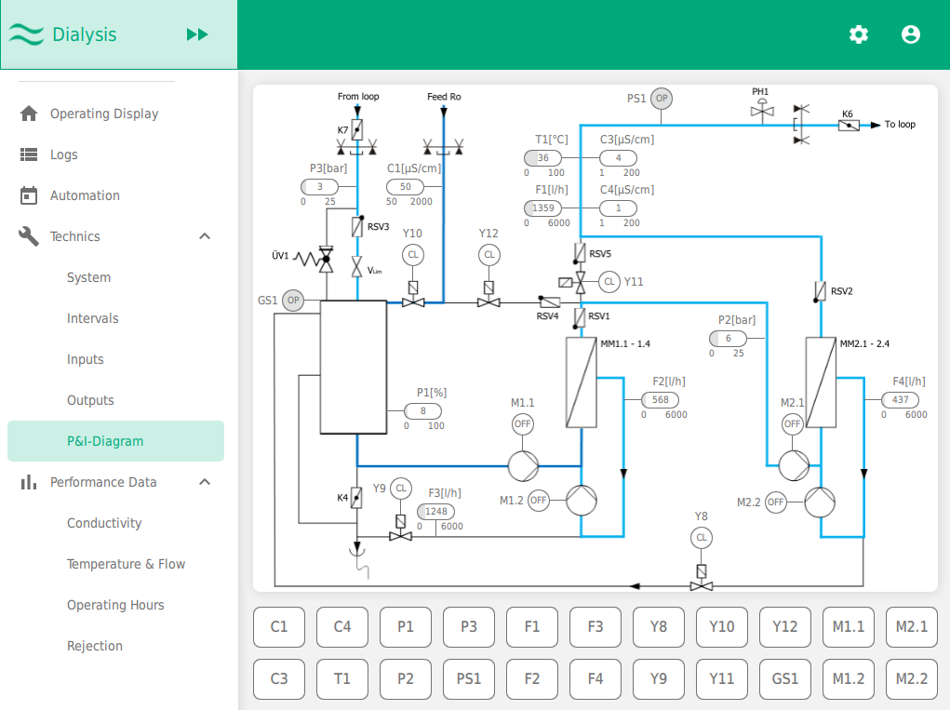
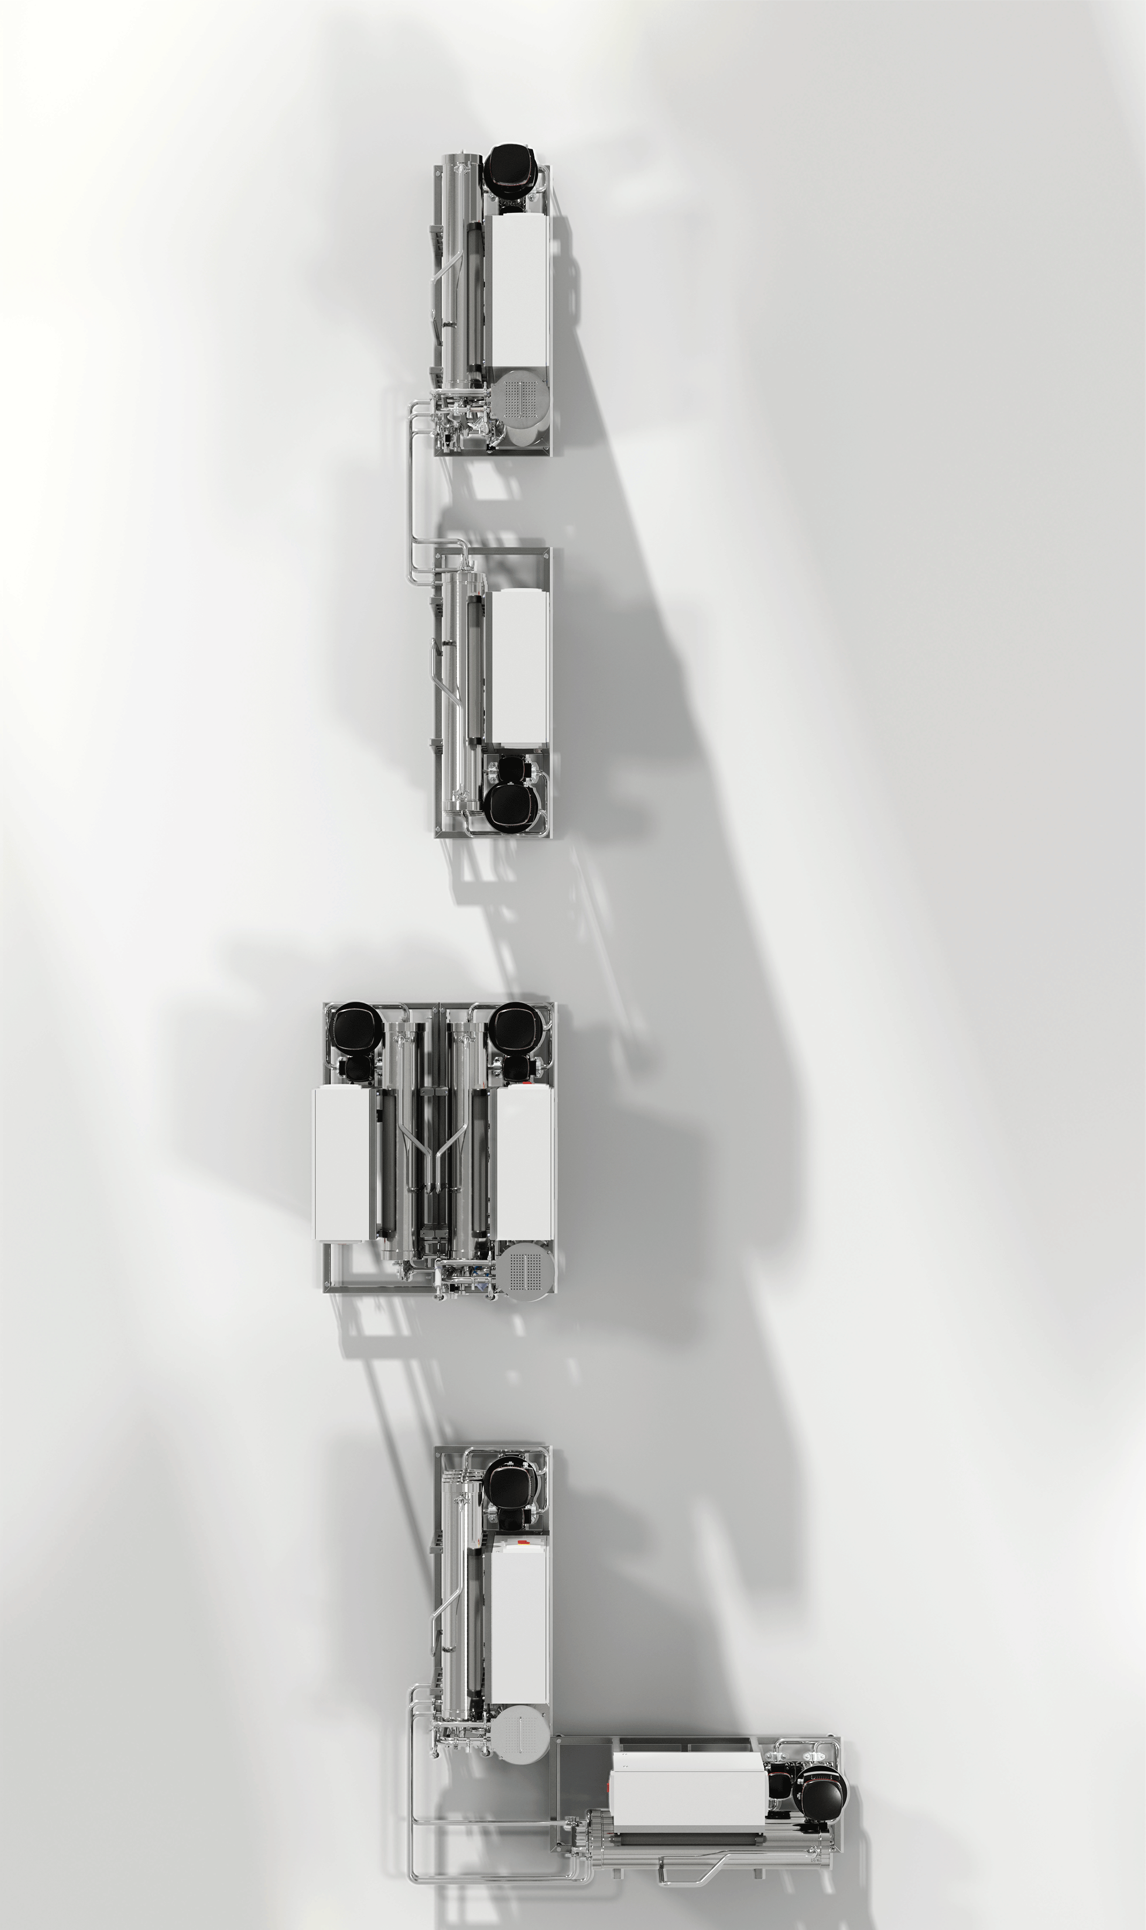

Reliability in product!
Improved usability
Maximized efficiency!

Slide 7

Most efficient device on the market!
AQUAboss® nX helps you to use fewer resources such as water and electricity thanks to intelligent and innovative technology.

Slide 8


Ressource Efficiency
Energy savings of
PATENTED TECHNOLOGY
Up to 65%
Thanks to multiple patents, AQUAboss® nX delivers a guaranteed minimum of 25% and up to 65% energy savings compared to AQUAboss®
This energy is enough to drive
an electric car around the world.*
For an average center with 100 patients this results in
7.650
Approx.
kW/h savings/year!
¹ Internal test report: Savings calculated according to performance KPI on 15000 treatments | *Electric car consumption: https://doi.org/10.1093/ndt/gfaa193

Slide 9


Ressource Efficiency
Water recovery rate
Up to 95%
of the input water is converted to permeate after removing impurities through a reverse osmosis system.
This means there is a potential of saving 10% more water in comparison to AQUAboss.

Slide 10

Ressource Efficiency
ECO-heat-on demand disinfection
A patented technology
PATENTED TECHNOLOGY
Calculates A0 value for reliable control
Reduces hot water consumption for target A0
Offers fully automated heat disinfection (HRS)
By calculating the A0 value, AQUAboss® nX
ensures reliable success control of the disinfection procedure.
Once the A0 value is reached, no additional hot water is needed for disinfection, markedly reducing hot water consumption.

Slide 11
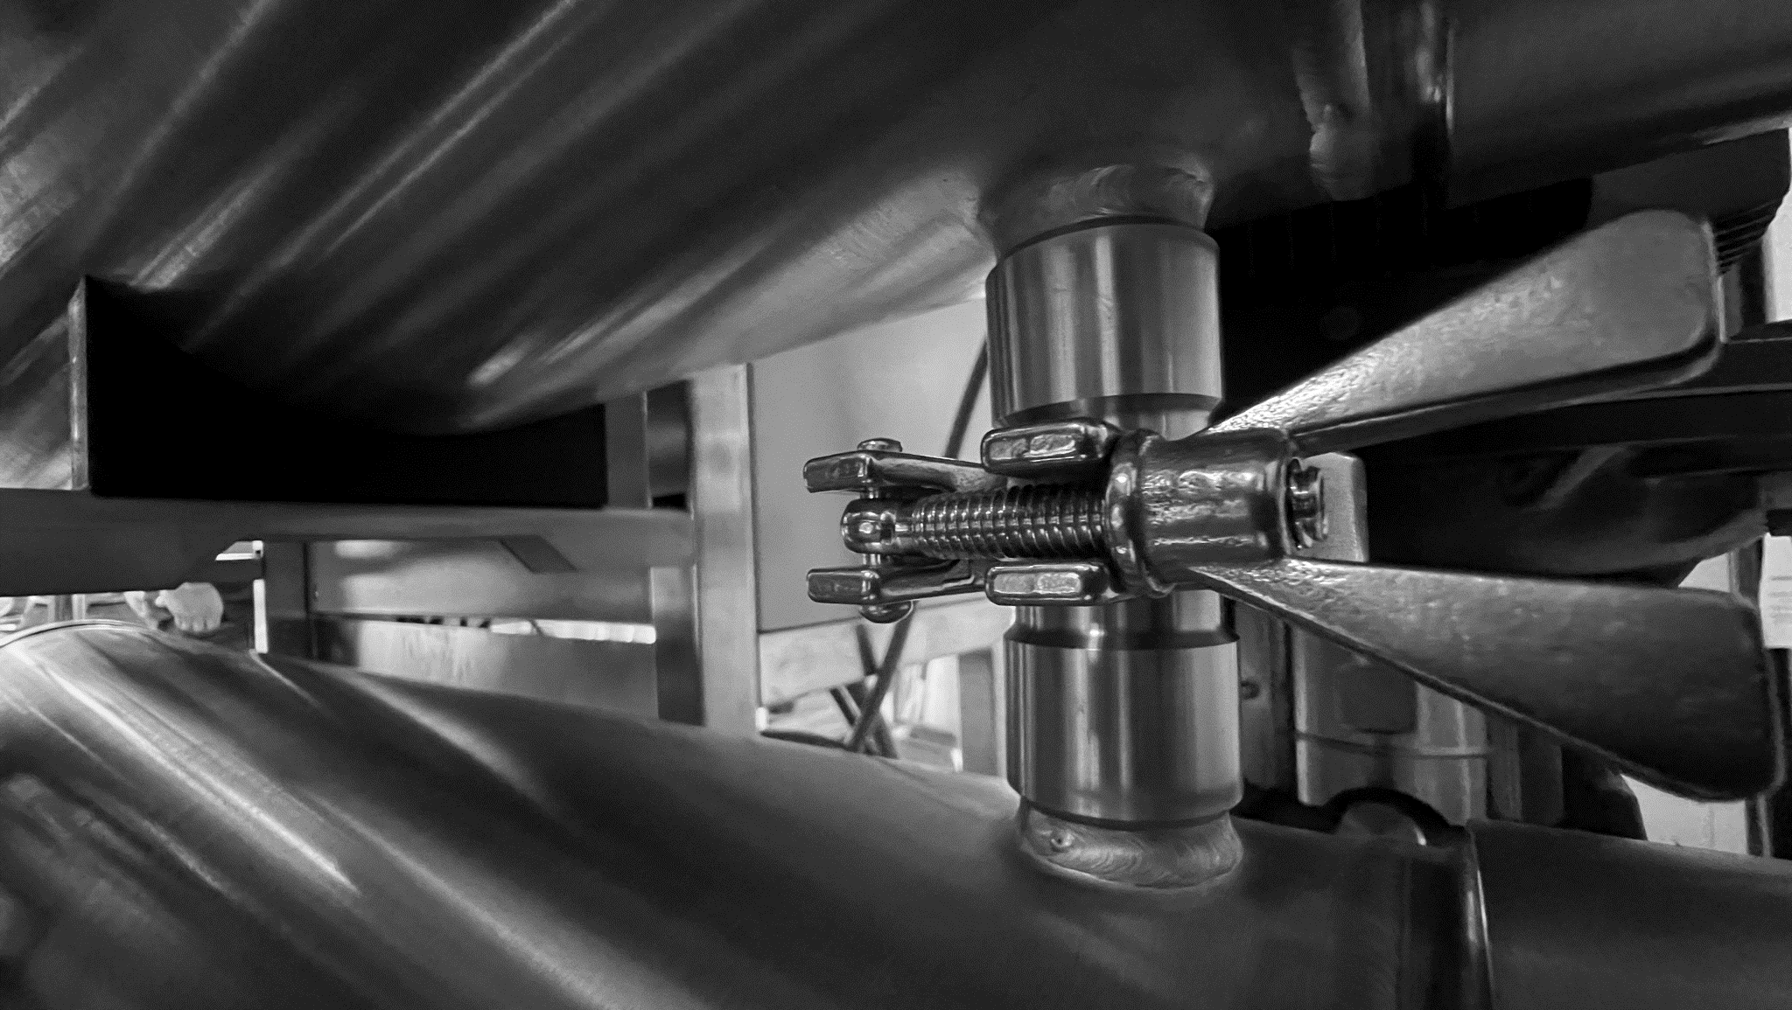
Reliability in product!
AQUAboss® nX is a reliable and user-friendly system specifically designed to significantly enhance performance, usability and sustainability.

Slide 12

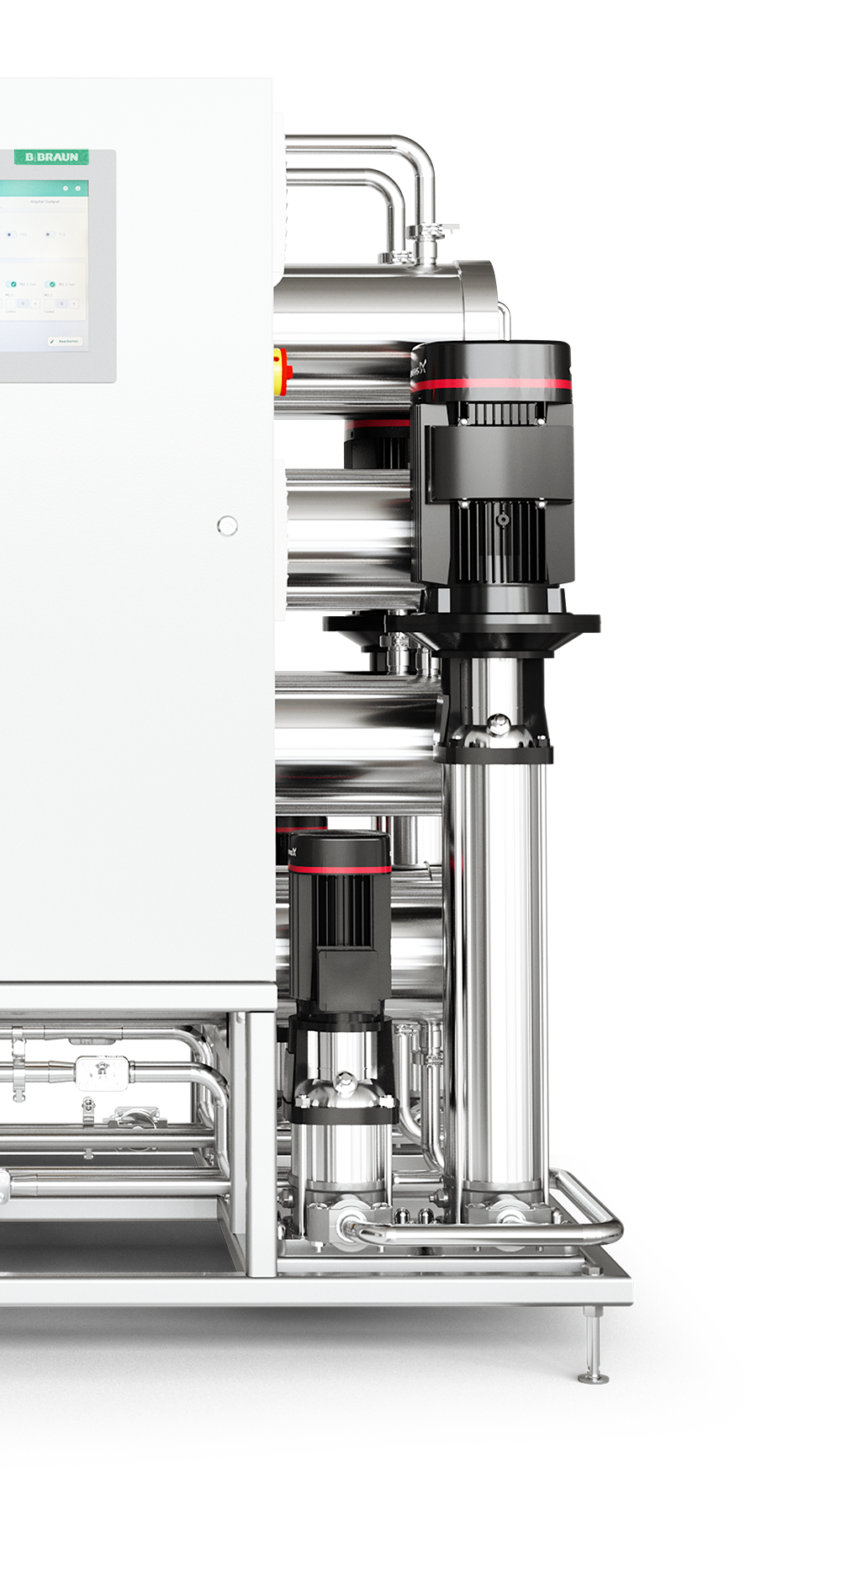
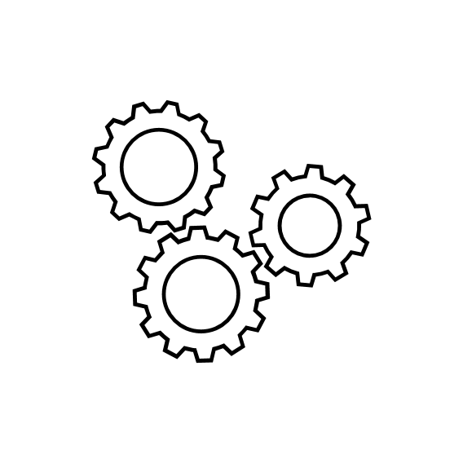
Component test
Reliability in product
PATENTED TECHNOLOGY
Thoroughly checks each solenoid valve on demand or after every restart
Prevents misdiagnosis and ensures safe operation
Makes the maintenance process seamless and efficient
Trust in AQUAboss® nX for reliability and peace of mind.

Slide 13

Leveled-up usability
Display emergency mode
Permeate supply is ensured, even in the event of
display failure
System can be operated at the touch of a button; status display via light signal
AQUAboss nX has a multifaceted safety concept that also takes display failure into account.
In the event of a display failure,
AQUAboss nX continues to work with all other functions.

Slide 14
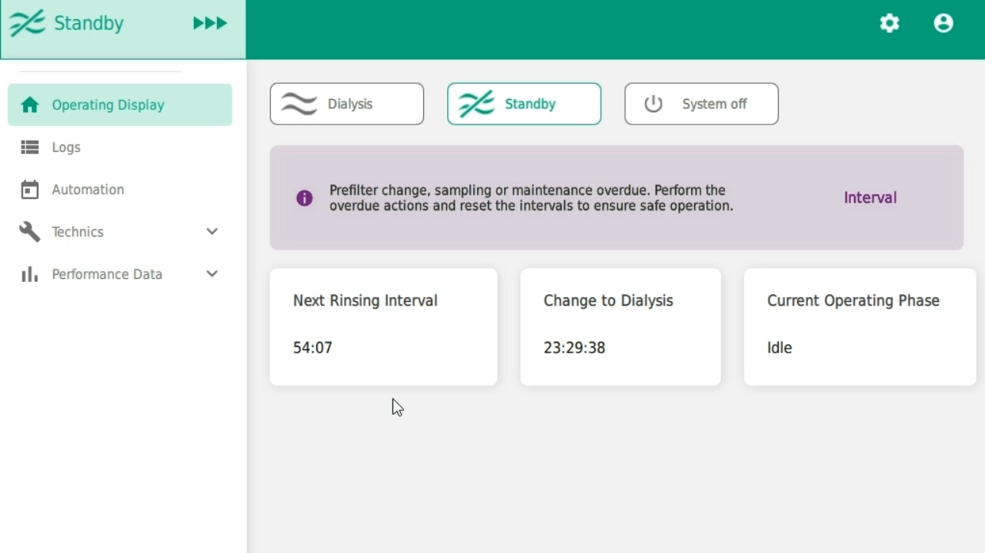
Eased Service

Slide 15
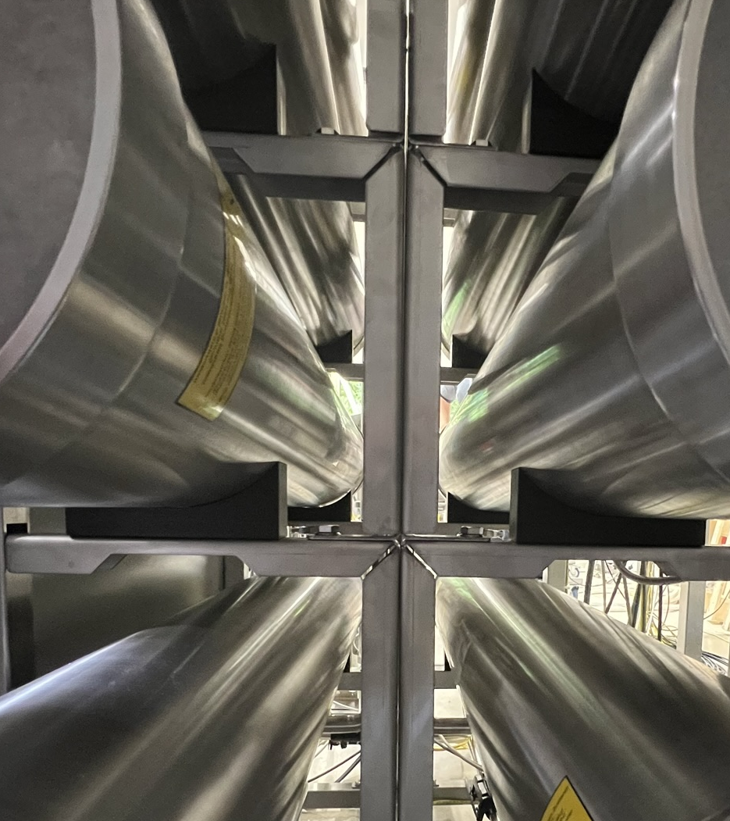
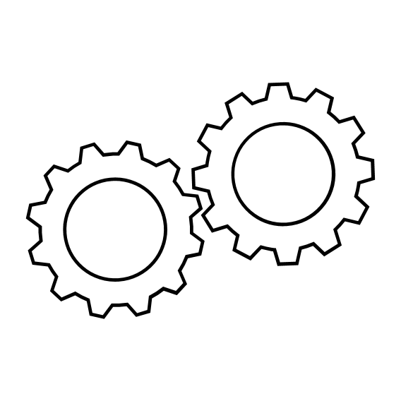
Reliability in product
Maintenance interval: 24 month!
Horizontally placed membranes
Less Screws for opening membrane housing
Extended maintenance interval of 24 months
Membranes can be replaced
without the need to dismantle the membrane housing.
With AQUAboss® nX, maintenance is completed more quickly, runs efficiently and needs to be carried out less frequently!

Slide 16
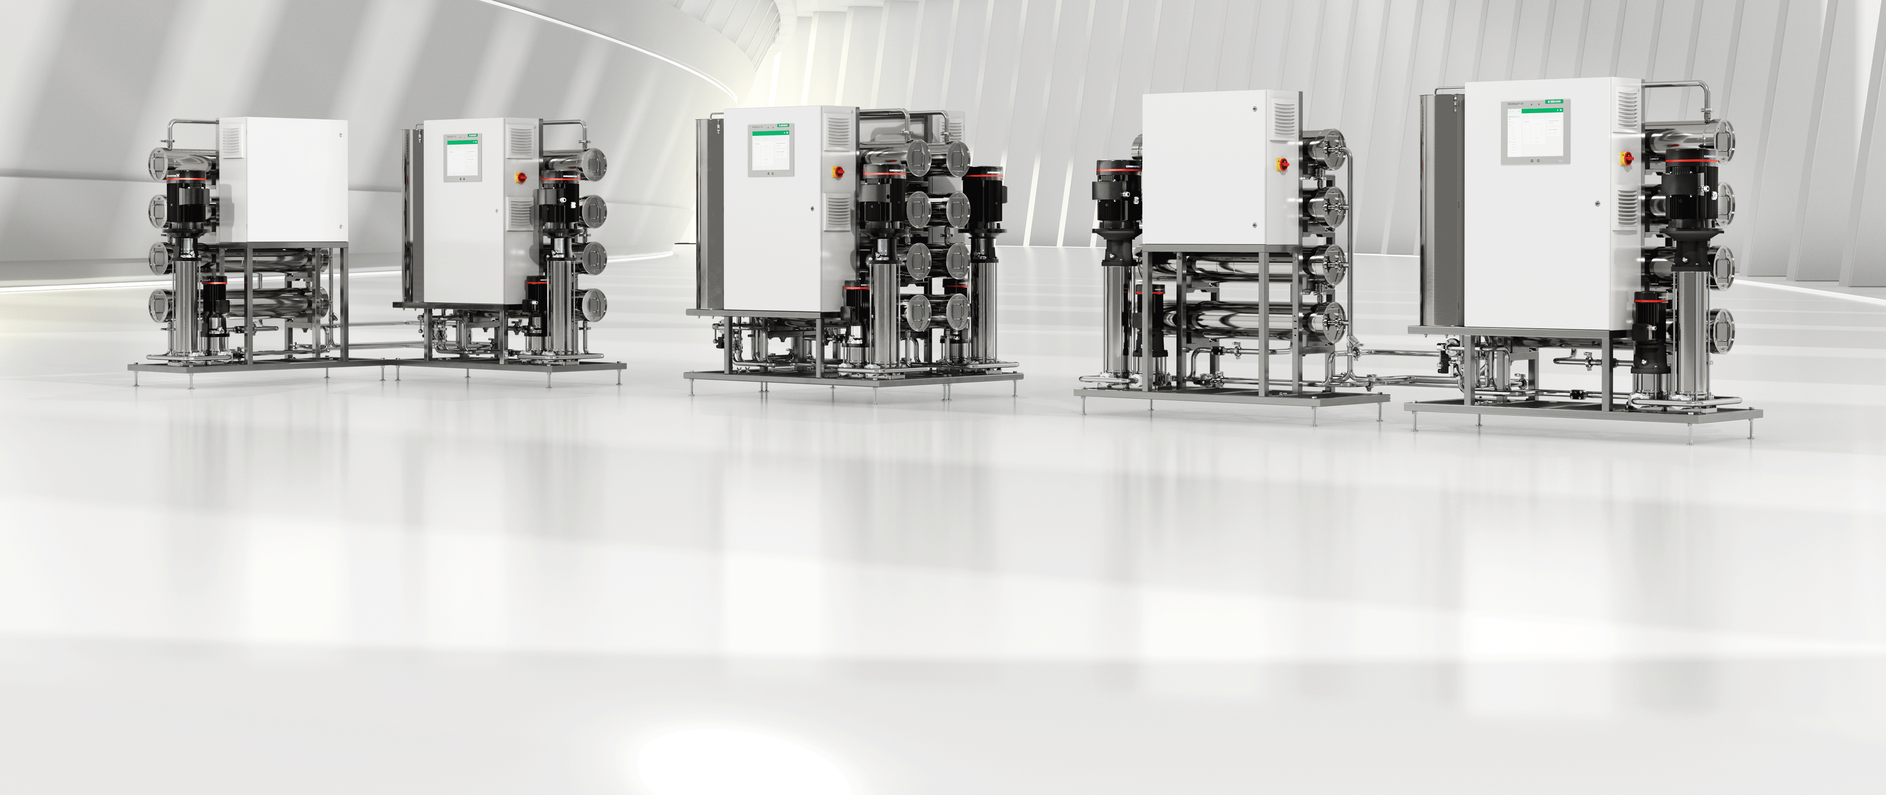

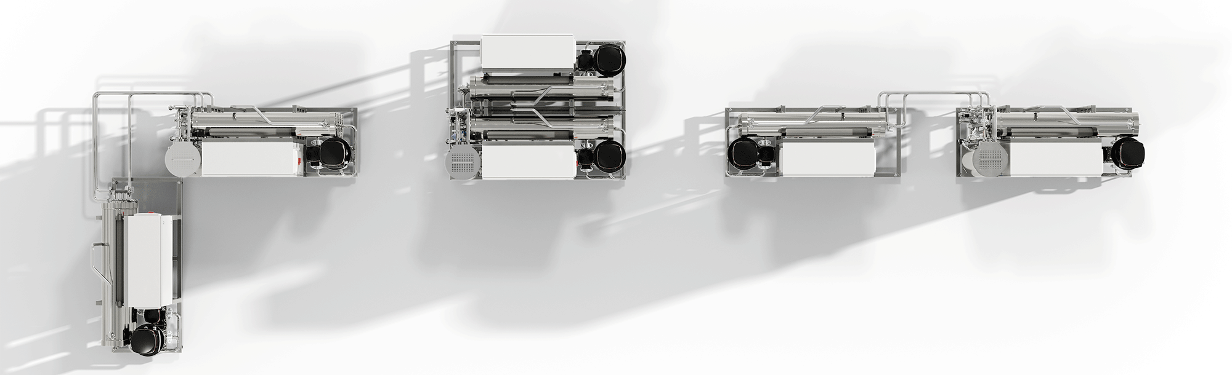
Reliability in product

Slide 17
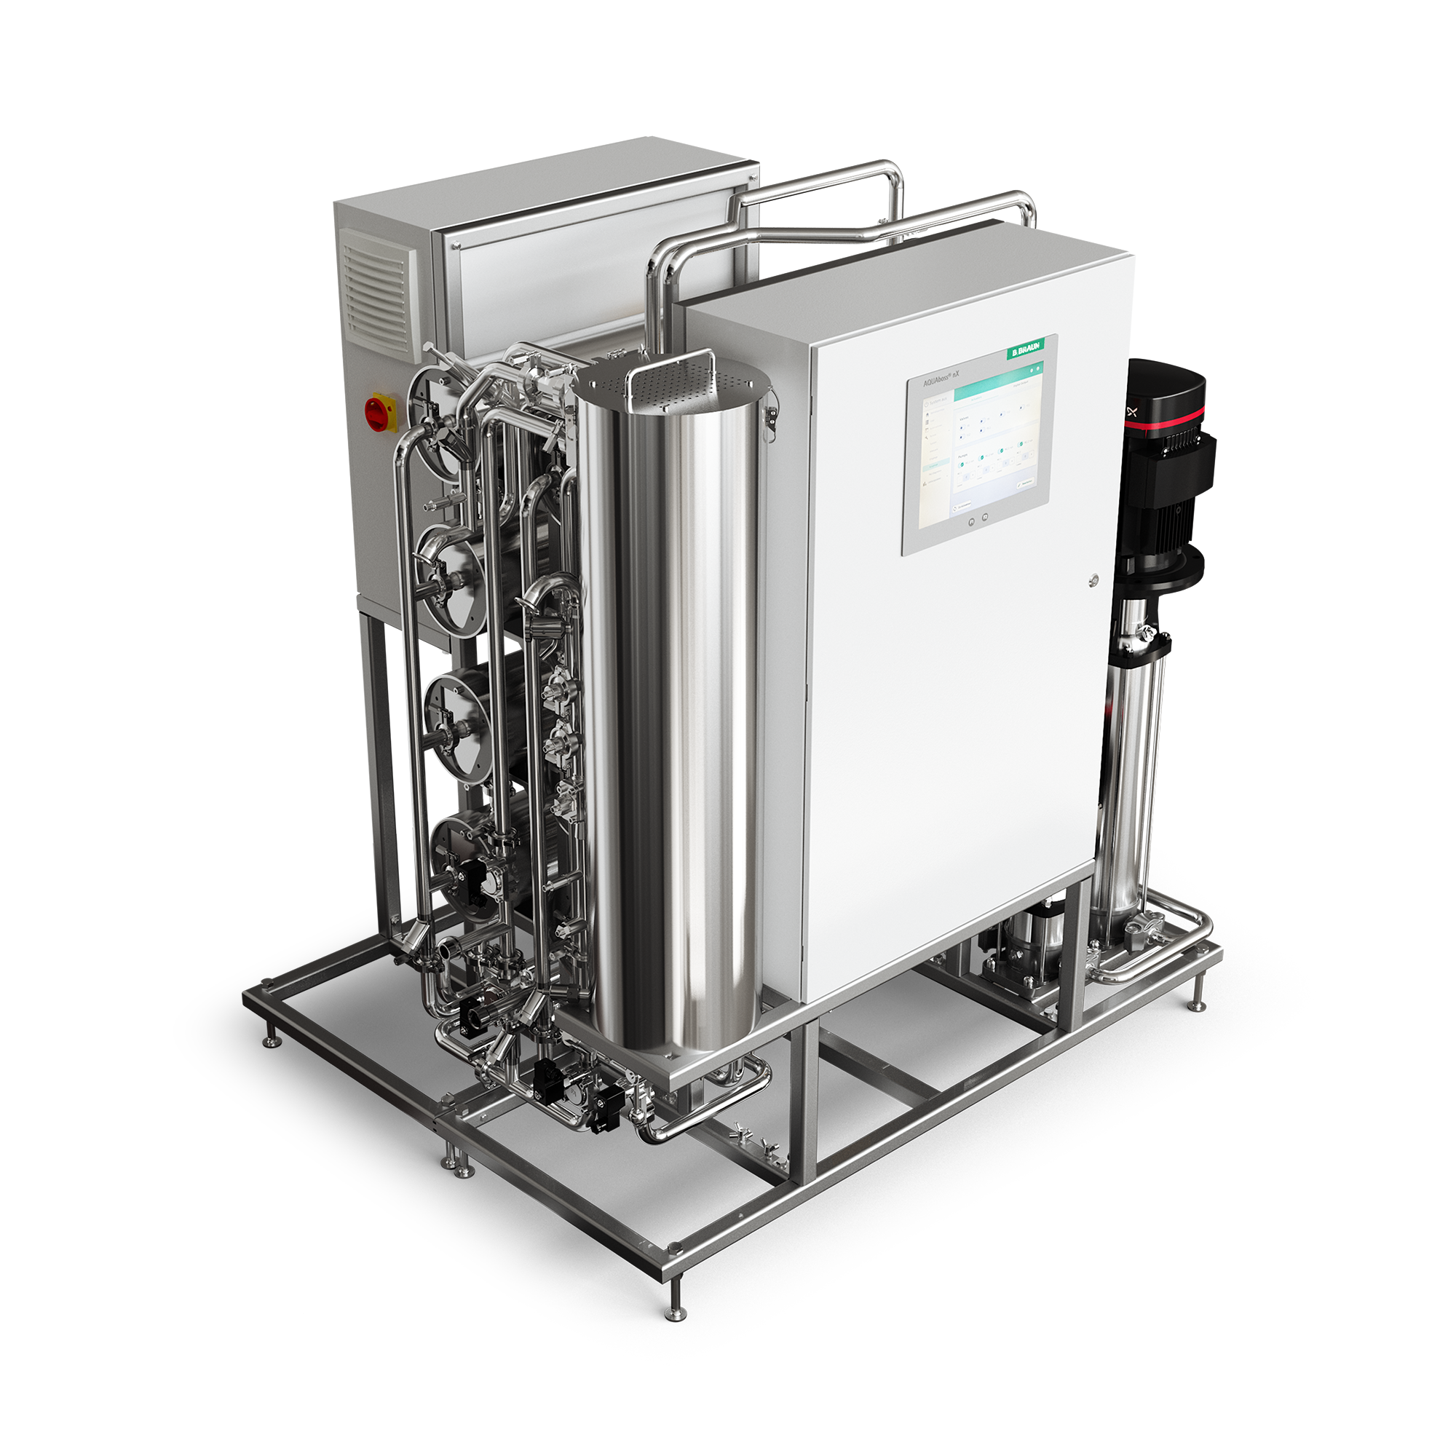
Reliability in product
Automatic emergency mode:
PATENTED TECHNOLOGY
Fully automated bypass of a stage in the event of a failure
Full system monitoring
Redundant conductivity monitoring
No manual valve positions or manual opening of valves
AQUAboss® nX relieves nurses and technicians of the burden of taking care of the permeate supply in the event of an alarm
AQUAboss® nX automatically switches to emergency mode & ensures a fully automated permeate supply for your patients.

Slide 18
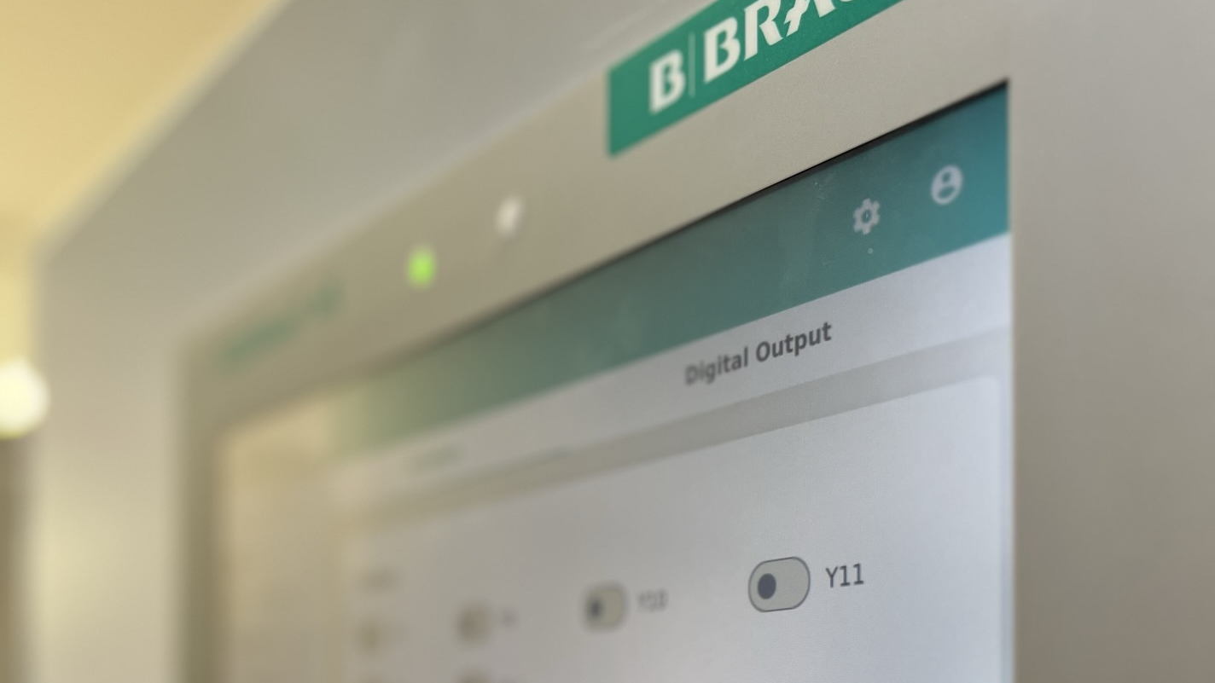
Leveled-up usability concept!
IMPROVED USABILITY PLACEHOLDER
AQUAboss® nX comes with an intuitive user concept for better software navigation, simple error identification and operates quite silent.

Slide 19
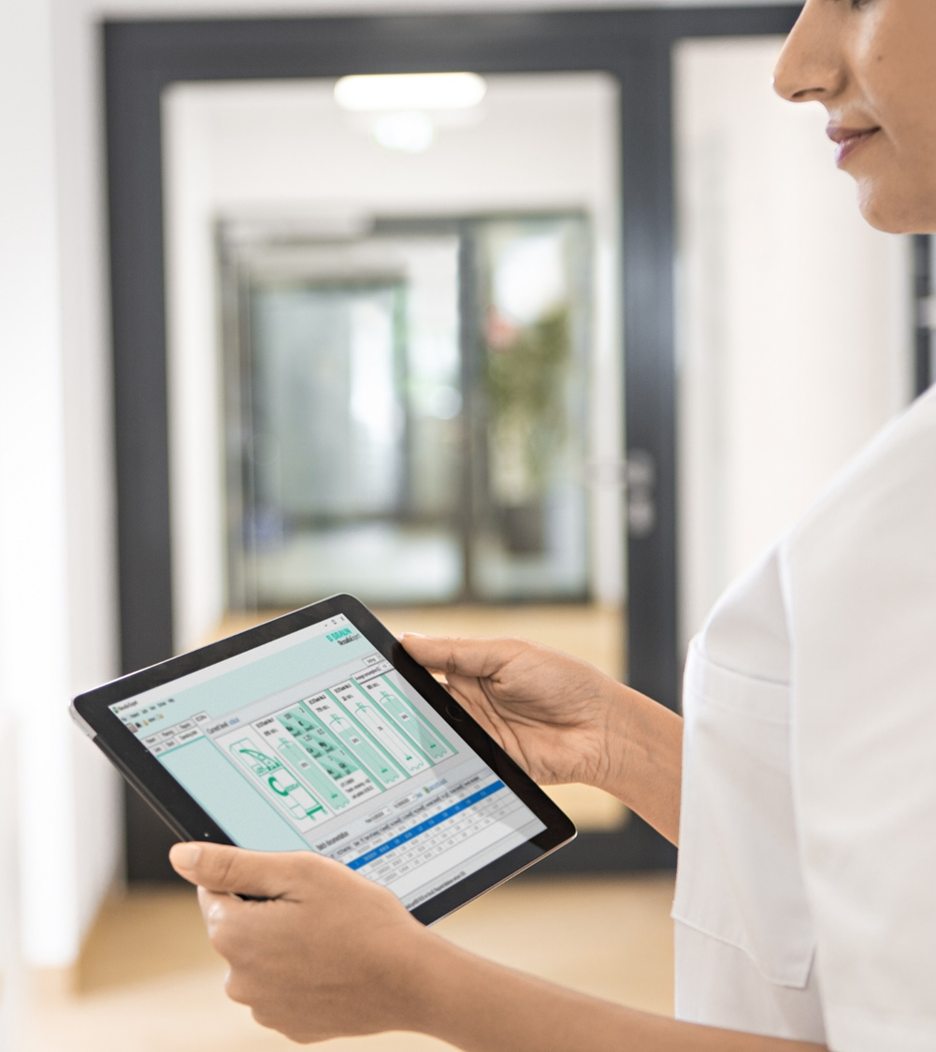

Leveled-up Usability
Stay connected! Remote & on-device monitoring
15” Touchscreen
Monitoring Software as a Standard
Dual conductivity monitoring
Important parameters can be
monitored, whether on the display or wherever you are!
AQUAboss® nX monitors and visualizes permeate temperature, conductivity and flow, displaying this data remotely and on the screen as a graph.

Slide 20

Leveled-up Usability
Quiet operation
<80db
Thanks to the improved operating mode of AQUAboss® nX, no hearing protection is required when working in the vicinity of the system as the upper limit of 80 dB is not exceeded.¹
¹ AQUAboss nX – IFU, page 29

Slide 21

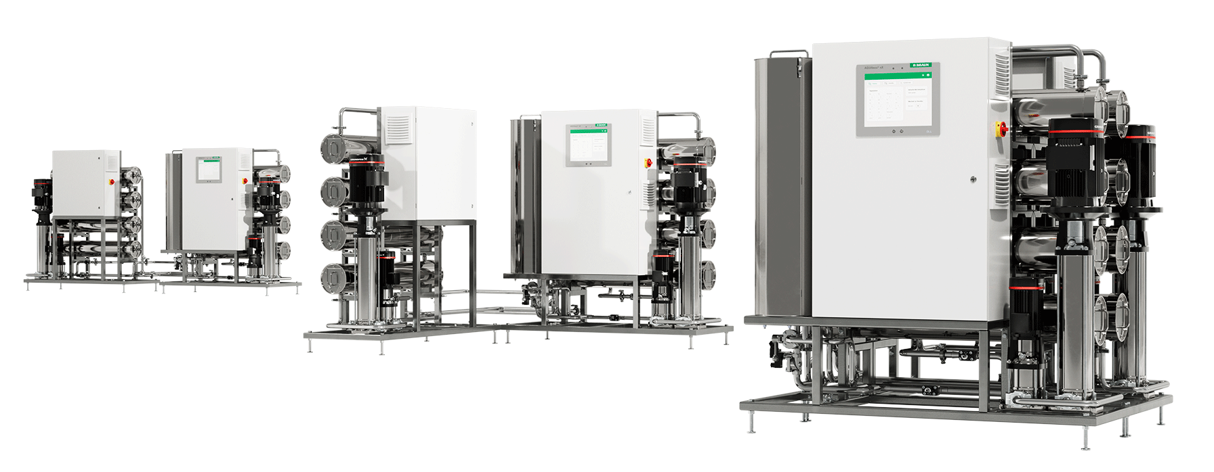

Let´s sum up!
Portfolio Range
Capacities from 500 – 4000 l/h
Available as a single or double stage device series
Chemical or heat disinfection options
AQUAboss® nX
Features
Optimized energy consumption
15” touchscreen display
Impulse washing as a standard
Low noise emissions
Safety mode
Sustainability
Water recovery rates of up to 95%
25% -65% energy savings compared to current AQUAboss series
Less disinfection & maintenance effort

Slide 22
Thank you and stay healthy!
2025, Patrick Weix
Notes:
categoryEnd:slideEnd

